Slide 1
University Training Docu-ments for SIMATIC PCS 7 Siemens Automation Cooperates with Education | 02/2020
Unrestricted for Educational and R&D Institutions. © Siemens 2020. All Rights Reserved.
siemens.com/sce

Slide 2
Learn-/Training Documents PCS 7 Contents
MODULE 1
P01-01 Process description
P01-02 Hardware configuration
P01-03 Plant hierarchy
P01-04 Individual drive functions
P01-05 Functional safety
P01-06 Control loop and other control functions
P01-07 Importing plant design data
P01-08 Sequential control systems
P02-01 HMI generation
P02-02 Alarm engineering
P02-03 Archiving and trend reporting
MODULE 2
Notes:
2

Slide 3
Learn-/Training Documents PCS 7 Module 1 P01-01 Process description
Objectives
Classification of process plants
P&ID of the laboratory plant
Interlocks and recipes for the laboratory plant
Notes:
3

Slide 4
PCS Training Curriculums Module 1 P01-01 Process description
Classification of process plants
Classification by the number of basically different products
Single product process plant
Multi-product process plant
Classification according to the physical structure of the plant
Single-train process plant
Multi-train process plant
Multi-train & multi-path process plant
Laboratory plant as learning example
Multi-product, multi-strand & multi-path plant
Hierarchical breakdown into 4 plant units
Notes:
4

Slide 5
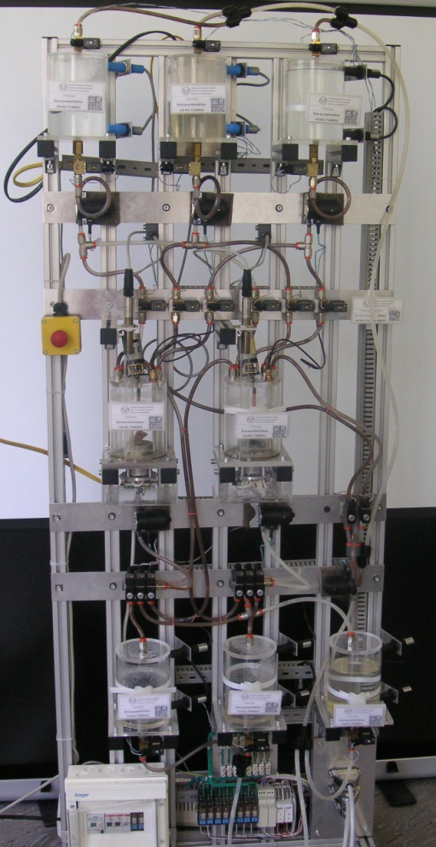
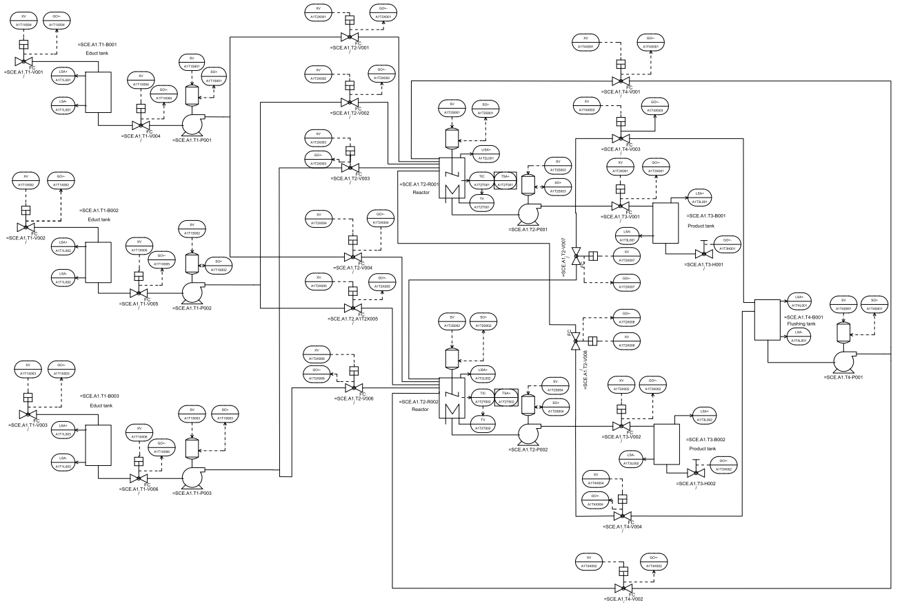
Learn-/Training Documents PCS 7 Module 1 P01-01 Process description
P&ID of the laboratory plant
Product tanks
Rinsing
Reactors
Educt tanks
Notes:
5

Slide 6
Learn-/Training Documents PCS 7 Module 1 P01-01 Process description
Interlocks and recipes
Safe operation of the plant requires monitoring of process interventions
Requirements for the laboratory plant:
Control of actuators only when the main power switch is on and EMERGENCY OFF is unlocked
Protection of the tanks against overflow
Prevent the intake of air at the pumps
Pumps must not work against closed valves
…
Production of a product requires a standard operating procedure
Recipe for laboratory plant:
350 ml of educt 3 to reactor 1 and 200 ml of educt 1 to reactor 2
Heating of reactor 1 up to 25 °C and 150 ml of educt 2 to reactor 2
…
Notes:
6

Slide 7
Learn-/Training Documents PCS 7 Module 1 P01-02 Hardware configuration
Objectives
Theory
Distributed structures
Connection to the process
Operating principle of a programmable logic controller (PLC)
Step-by-step instruction
Creating a project
Configuring the hardware
Configuring the communication
Notes:
7

Slide 8
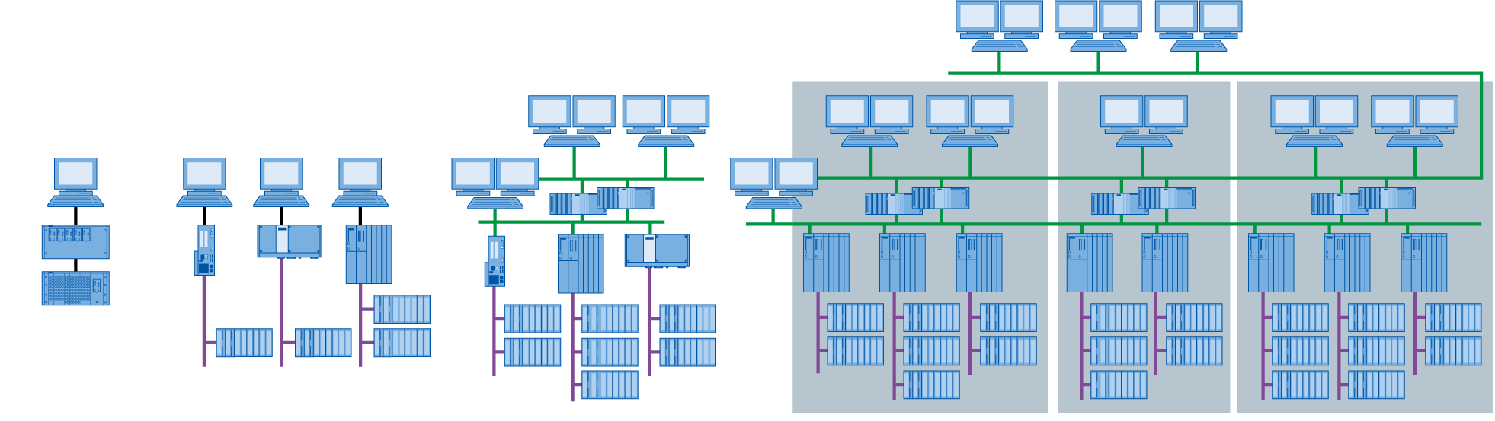
Learn-/Training Documents PCS 7 Module 1 P01-02 Hardware configuration
Distributed structures of process control systems
Special structures lead to scalable process control systems
Structures are component based and can be easily expanded
Typical structure:
Process management level
Control level
Field level
Laboratory
Test center
Production plant
Connected facilities at one production site
SIMATIC PCS 7 LAB
SIMATIC PCS 7: 100 to 120 000 I/Os
Notes:
8

Slide 9
Learn-/Training Documents PCS 7 Module 1 P01-02 Hardware configuration
Connection to the process
Two typical ways to connect sensors and actuators to the process control system
Directly via a bus system (intelligent devices)
To a signal module via a standard electrical signal
Signal modules for
Binary signals: DI/DO modules (DI .. digital input, DO .. digital output)
1 bit of memory required per signal
Analog signals: AI/AO modules (AI .. analog input, AO .. analog output)
16 bits of memory required per signal
Resolution can still be less, for example, 12 bits
Notes:
9

Slide 10
Learn-/Training Documents PCS 7 Module 1 P01-02 Hardware configuration
Operating principle of the PLC
Component on control level typically is a PLC
Input and output signals are read and written cyclically and buffered in the process image
Consistency of signals during program processing by accessing process image
Outputs
Initialization
Process image outputs
Inputs
Read the inputs
Process image inputs
Processing of operations of program blocks
Typical processing times:
1µs Bit operations 2µs Word operations
12µs Timer/counter operation 3µs Fixed-point addition
50µs Floating-point addition
Outputs
Write the outputs
Process image outputs
Legend:
Access to hardware
Access to process image
Processing sequence
Notes:
10

Slide 11
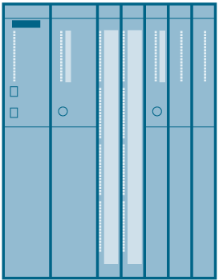
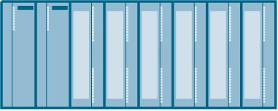
Learn-/Training Documents PCS 7 Module 1 P01-02 Hardware configuration
Hardware configuration of the laboratory plant
AS
PS
CPU (with PROFIBUS)
ET 200M (with PROFIBUS)
7x DI
3x DO
1x AI
1x AO
CP (with Ethernet)
OS
PC (with Ethernet)
PC station as ES and OS with PCS 7 software and WinCC for visualization
Ethernet connection
S7 station as AS (here: CPU414-3DP)
PROFIBUS DP
ET 200M for I/O coupling
Notes:
11

Slide 12
Learn-/Training Documents PCS 7 Module 1 P01-03 Plant hierarchy
Objectives
Theory
Structuring the laboratory plant
Deriving the visualization
Plant hierarchy (PH) and structure of visualization
Step-by-step instruction
Opening the plant view
Creating the plant hierarchy
Basic settings of the plant hierarchy
Notes:
12

Slide 13
Learn-/Training Documents PCS 7 Module 1 P01-03 Plant hierarchy
Structuring the laboratory plant
Structuring based on function aspect
Hierarchical breakdown into units
Unit 1: educt tanks
Unit 2: reactors
Unit 3: product tanks
Unit 4: rinsing
Design of an identification system according to ISA-88
Process cell: A1
Unit: T1 .. T4
Equipment module: B001, …, B003, R001, …
Control module: pump, valve, level, agitator, …
Notes:
13

Slide 14
Learn-/Training Documents PCS 7 Module 1 P01-03 Plant hierarchy
Deriving the visualization
Deriving the visualization in the operator system (OS) through the following steps:
Structuring the laboratory plant
Creating the plant hierarchy
Selection of a hierarchy level as OS area
Running the generating process (see P02-01 HMI generation)
All hierarchy levels below the level defined as OS area can be displayed automatically
Area identification
Navigation hierarchy
Operating icons for implemented function blocks
Group alarms
Notes:
14

Slide 15
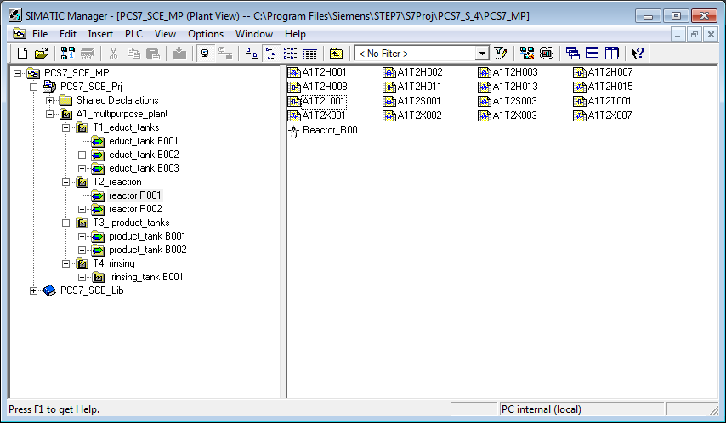
Learn-/Training Documents PCS 7 Module 1 P01-03 Plant hierarchy
Plant hierarchy and the effect on visualization
A1_multipurpose plant
OS area
T1_educt tanks
T2_reaction
T3_product tanks
T4_rinsing
Educt tank B001
Educt tank B002
Educt tank B003
Reactor R001
Reactor R002
Product tank B001
Product tank B002
Rinsing tank B001
Operating screens
Notes:
15

Slide 16
Learn-/Training Documents PCS 7 Module 1 P01-04 Individual drive functions
Objectives
Theory
Terminology of individual drive functions (IDF)
Individual drive functions in PCS 7
Individual drive function Motor
Step-by-step instruction
Creating symbol tables
Creating CFC for IDF Motor
Testing the IDF
Notes:
16

Slide 17
Learn-/Training Documents PCS 7 Module 1 P01-04 Individual drive functions
Individual drive functions (IDF)
Hierarchical structuring of the plant according to DIN EN 61512
Level 0: Control module
Control module is a recurring element
Project wide
For more than one project
Reusing possible
Advantages:
Parameterization instead of programming
Tested functionality
Consistent handling and visualization
Type definition of control modules
e. g. motor, valve, …
Enterprise
may contain
Site
may contain
Area
may contain
Process cell
must contain
Unit
may contain
Equipment module
may contain
may contain
Control module
may contain
Notes:
17

Slide 18
Learn-/Training Documents PCS 7 Module 1 P01-04 Individual drive functions
Individual drive functions in PCS 7
Function blocks as object-oriented model of an equipment module
e. g. motors and valves
Functions:
Control and control mode
Protection and monitoring functions
Operator control and visualization functions
Messaging and alarm functions
Function block as object-oriented model of a (measuring) signal
e.g. digital output, digital input, analog output, analog input
Functions:
Scaling the digital value to the physical value range
Monitoring the signal quality
Notes:
18

Slide 19
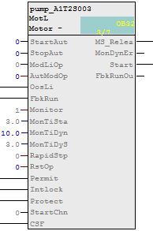
Learn-/Training Documents PCS 7 Module 1 P01-04 Individual drive functions
Individual drive function MotL (PCS 7 Advanced Process Library)
Function block MotL
Used for controlling pumps/agitators in the laboratory plant
Properties:
Control with one control signal (on/off)
Monitoring function through running feedback
Advantages:
No programming of the control, protection and monitoring functions
Uniform parameters
Uniform visualization (see P02-01 HMI generation)
Notes:
19

Slide 20
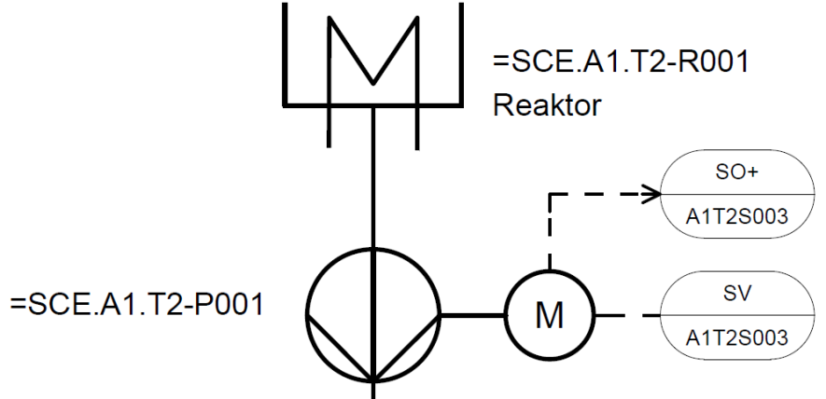
Learn-/Training Documents PCS 7 Module 1 P01-04 Individual drive functions
Implementation of a pump of the laboratory plant
Pump SCE.A1.T2-P001 for draining the reactor content
Pump is driven by a motor
Motor has the following signals:
Signal for control
Signal for running feedback
Template from PCS 7 AP library
MotorLean
Reactor
Symbol | Address | Data type | Symbol comment
A1.T2.A1T2S003.SO+.O+ | I 1.3 | BOOL | pump outlet reactor R001 feedback on
A1.T2.A1T2S003.SV.C | Q 3.4 | BOOL | pump outlet reactor R001 actuating signal
Notes:
20

Slide 21
Learn-/Training Documents PCS 7 Module 1 P01-05 Functional safety
Objectives
Theory
Functional safety with tools of process control engineering (PCE)
Standard circuits for functional safety
Design of an interlock for the laboratory plant
Step-by-step instruction
Creating CFC for manual operation of the motor
Adding the interlock for motor in CFC
Interconnections between CFCs
Notes:
21

Slide 22
Learn-/Training Documents PCS 7 Module 1 P01-05 Functional safety
Functional safety with tools of process control engineering (PCE)
Protection of process plants against fault states
In reference to the process variables, there are 3 value ranges
process value
Curve 1
Curve 2
Curve 3
Non-PCE protective device responds
Event-preventing PCE protective responds
Non-intended use
Non-permissible deviation
Permissible deviation
Limit value of protective equipment
Process-related limit value
Intended use
Limit value of monitoring device
Acceptance region
PCE monitoring device responds
time
Notes:
22

Slide 23
Learn-/Training Documents PCS 7 Module 1 P01-05 Functional safety
Design of the interlock for the pump of the laboratory plant
The pump may only be turned on when the main switch of the plant is switched on and the Emergency Off switch is unlocked
The pump must not take in air, which means the level of the reactor has to be at least 50 ml
The pump must not work against closed valves, which means at least one valve has to be open
Symbol | Address | Data type | Symbol comment
A1.A1H001.HS+-.START | I 0.0 | BOOL | Switch on main power switch
A1.A1H002.HS+-.OFF | I 0.1 | BOOL | Activate EMERGENCY OFF
A1.T2.A1T2L001.LISA+.M | IW 72 | WORD | Actual value level reactor R001
A1.T2.A1T2X007.GO+-.O+ | I 66.3 | BOOL | Open/Closed valve … feedback signal
A1.T3.A1T3X001.GO+-.O+ | I 67.4 | BOOL | Open/Closed valve … feedback signal
A1.T4.A1T4X003.GO+-.O+ | I 68.2 | BOOL | Open/Closed valve … feedback signal
Notes:
23

Slide 24
Learn-/Training Documents PCS 7 Module 1 P01-05 Functional safety
Standard circuits for functional safety
Replacement of analog value A1.T2.A1T2L001.LISA+.M by a binary value that is the result of the comparison with 50 ml
Function table for design of combinatorial circuit
Result according to conjunctive normal form (CNF) is used for the interlock of the pump
A1T2L001 > 50ml | A1T2X007 | A1T3X001 | A1T4X003 | LOCK
x | x | x | x | 0
x | x | x | x | 0
0 | x | x | x | 0
x | 0 | 0 | 0 | 0
1 | 1 | x | x | 1
1 | x | 1 | x | 1
1 | x | x | 1 | 1
Notes:
24

Slide 25
Learn-/Training Documents PCS 7 Module 1 P01-06 Control loop and other control functions
Objectives
Theory
Structure of a control loop
PID controller
Temperature control of the laboratory plant
Step-by-step instruction
Parameterization of a continuous controller
Output of the analog manipulated variable as a binary signal with a pulse generator
Notes:
25

Slide 26
Learn-/Training Documents PCS 7 Module 1 P01-06 Control loop and other control functions
Structure of a control loop
Process variables have to keep or achieve certain values
Disturbance behavior: A certain value has to be kept in spite of disturbances
Response to setpoint changes: Setpoint shall be achieved in a dynamic and stable manner
Control loop works as follows:
Process variable or controlled variable is measured by a sensor
Setpoint minus measured value equals the system deviation
Controller calculates a value of the manipulated variable for the actuator on the basis of the deviation
Actuator acts on the system
Disturbance variables z
(System) deviation e
Manipulated variable y
Process variable = controlled variable x
Loop controller
System
Setpoint w
+
-
Notes:
26

Slide 27
Learn-/Training Documents PCS 7 Module 1 P01-06 Control loop and other control functions
PID controller
Control algorithm calculates the value of the manipulated variable from the deviation
Process industry uses the PID algorithm to 95%
P stands for proportional
Current manipulated variable value depends only on the current deviation
I stands for integral
Current manipulated variable value depends on the sum of the last deviations
D stands for differential
Current manipulated variable value depends on the change of the deviation
Only three parameters (gain, integral-action time and derivative-action time) have to be adjusted
Practical tuning rules exist for processes without dominant dead times
Ziegler and Nichols method
Chien, Hrones and Reswick
Notes:
27

Slide 28
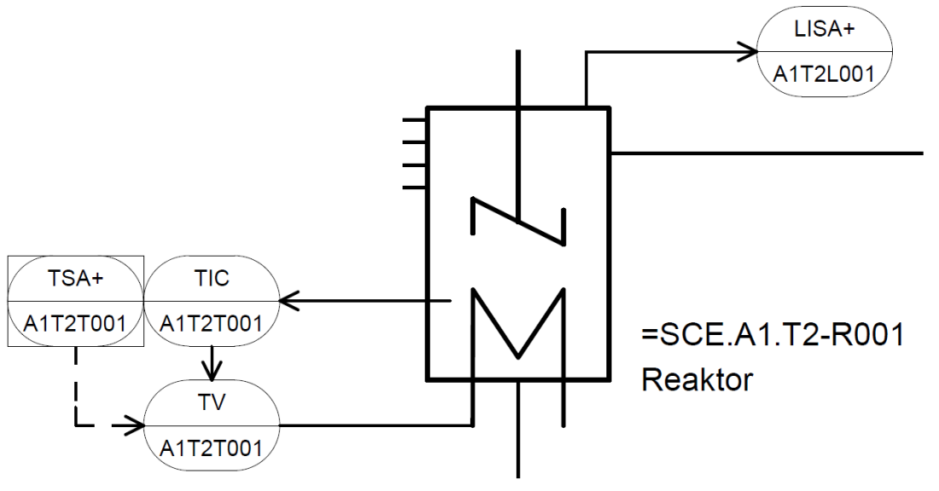
Learn-/Training Documents PCS 7 Module 1 P01-06 Control loop and other control functions
Temperature control of the laboratory process cell
Control loop
Process variable/controlled variable is A1.T2.A1T2T001.TIC.M
Manipulated variable is A1.T2.A1T2T001.TV.S
Setpoint is
Determined by recipe
Determined by operator
Interlocked
Interlock conditions
Level in the reactor has to be at least 200 ml
Temperature must not exceed 60 °C
Notes:
28

Slide 29
Learn-/Training Documents PCS 7 Module 1 P01-07 Importing plant design data
Objectives
Theory
Design of complex systems
Process tag type
Model
Step-by-step instruction
Importing plant design data using the Import/Export Assistant
Importing plant design data in the process object view
Duplicating charts by creating process tag types/models
Notes:
29

Slide 30
Learn-/Training Documents PCS 7 Module 1 P01-07 Importing plant design data
Design of complex systems
Three general design principles
Principle of hierarchical arrangement
Plant hierarchy
Principle of modularization
Scope and complexity of blocks, CFC and SFC
Principle of reuse
Process tag types and models
Reuse also implies
Use of proven solutions (standards)
Central modifiability
Tested implementation
Notes:
30

Slide 31
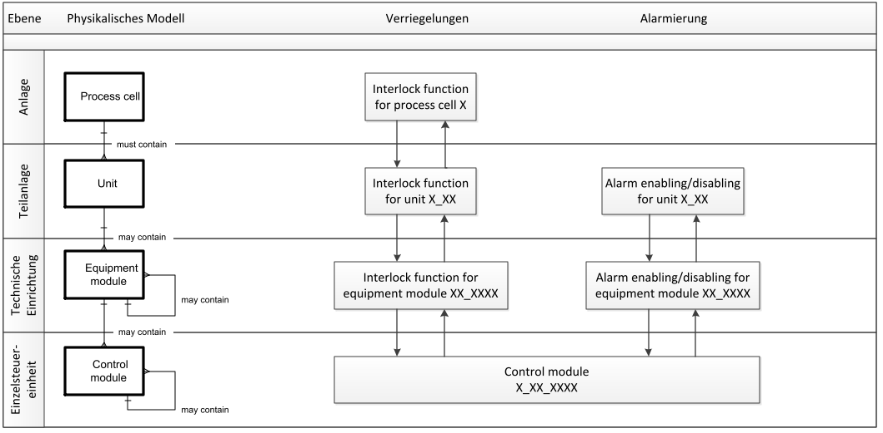
Learn-/Training Documents PCS 7 Module 1 P01-07 Importing plant design data
Process tag types and models
Process tag type (CFC) – corresponds to control module level
Model (entire hierarchy) – corresponds to equipment module or unit level
Level
Physical model
Interlock
Alarm management
Process cell
very individual
Unit
Equipment module
copying possible
for the most part
Control module
types can be created
Notes:
31

Slide 32
Learn-/Training Documents PCS 7 Module 1 P01-07 Importing plant design data
Process tag type and model of the laboratory plant
Selecting similar control modules
Pumps
A1T1P001, A1T1P002, A1T1P003 and A1T4P001
A1T2P001 and A1T2P002
Valves
A1T1V001, A1T1V002, A1T1V003, .. , A1T1V006
...
Selecting similar equipment modules
Tanks
A1T1B001, A1T1B002 and A1T1B003
A1T2R001 and A1T2R002
A1T3B001 and A1T3B002
Notes:
32

Slide 33
Learn-/Training Documents PCS 7 Module 1 P01-08 Sequential control systems
Objective
Theory
Structure of sequential function charts
Design of a sequential control system
Recipe of the laboratory plant
Step-by-step instruction
Creating and editing a sequential function chart (SFC)
Linking of SFC and CFC
Testing the SFC
Notes:
33

Slide 34
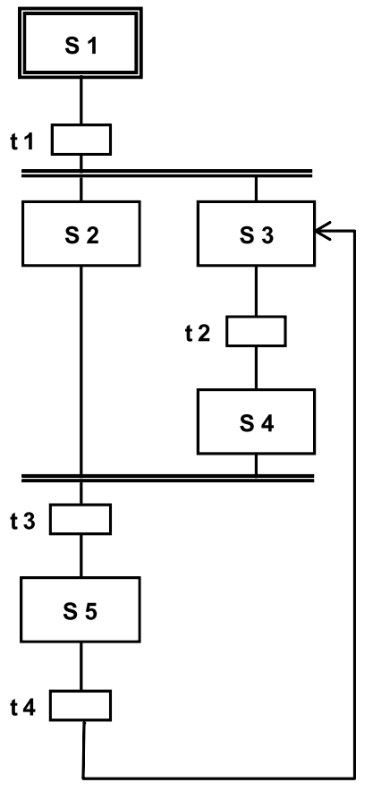
Learn-/Training Documents PCS 7 Module 1 P01-08 Sequential control systems
Structure of sequential function charts
Alternating sequence of steps and transitions
First step: initial step
Lasat step: final step
Structures:
Unbranched sequential function chart
Alternative branches
Parallel branches
Illegal structures:
Uncertain sequence – accessibility not assured
Partial deadlock – internal infinite loop
Total deadlock – no permissible step enabling condition
One time or cyclical processing of sequential function chart is possible
Notes:
34

Slide 35
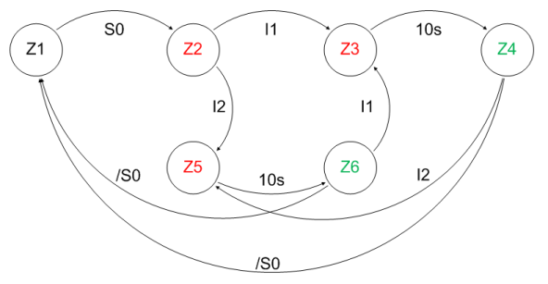
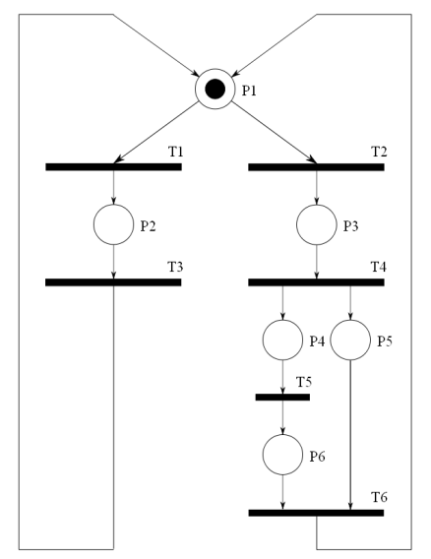
Learn-/Training Documents PCS 7 Module 1 P01-08 Sequential control systems
Design of a sequential control system
Proven design method for sequential control systems
State diagrams
Connected and directed graph
States shown as circles – can be linked with actions
State transitions shown as arrows – can be subject to transition conditions
Petri nets
Consists of locations and transitions
Locations shown as circles
Transitions shown as rectangles/bars
Parallel sequences can be displayed
Notes:
35

Slide 36
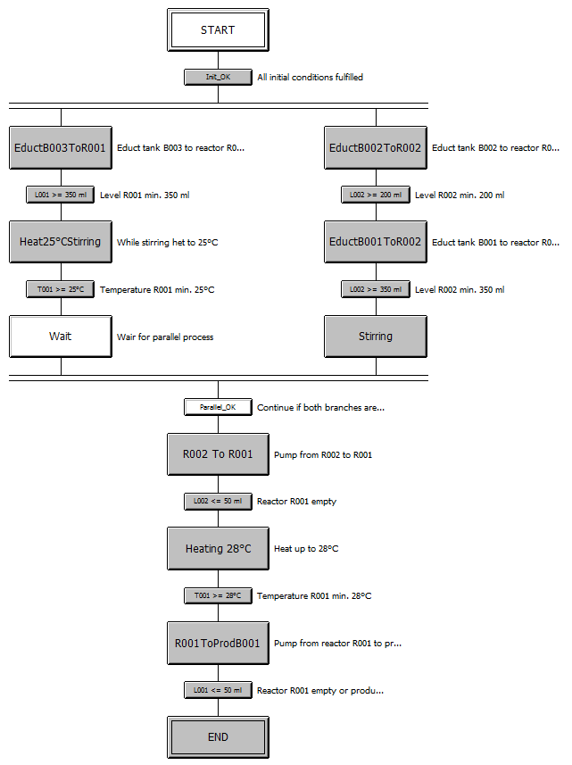
Learn-/Training Documents PCS 7 Module 1 P01-08 Sequential control systems
Recipe of the laboratory plant
First, 350 ml are to be drained from educt tank A1.T1.B003 into reactor A1.T2.R001 and at the same time 200 ml from educt tank A1.T1.B002 into reactor A1.T2.R002.
When reactor A1.T2.R001 is filled, the liquid is to be heated to 25 °C with the agitator switched on.
When filling of reactor A1.T2.R002 is finished, 150 ml from educt tank A1.T1.B001 is to be added to reactor A1.T2.R002. When this is finished, the agitator of reactor A1.T2.R002 is to be switched on 10 s later.
When the temperature of the liquid in reactor A1.T2.R001 has reached 25 °C, the mixture is to be pumped from reactor A1.T2.R002 to reactor A1.T2.R001.
Now, the mixture in reactor A1.T2.R001 is to be heated to 28 °C and then drained into product tank A1.T3.B001.
Notes:
36

Slide 37
Learn-/Training Documents PCS 7 Module 2 P02-01 HMI generation
Objectives
Theory
Concepts of representation
HMI generation in PCS 7
Graphics of the laboratory plant
Step-by-step instruction
Generating the operator station (OS) in SIMATIC Manager
Configuration environment WinCC
Creating pictures with the Graphics Designer
Notes:
37

Slide 38
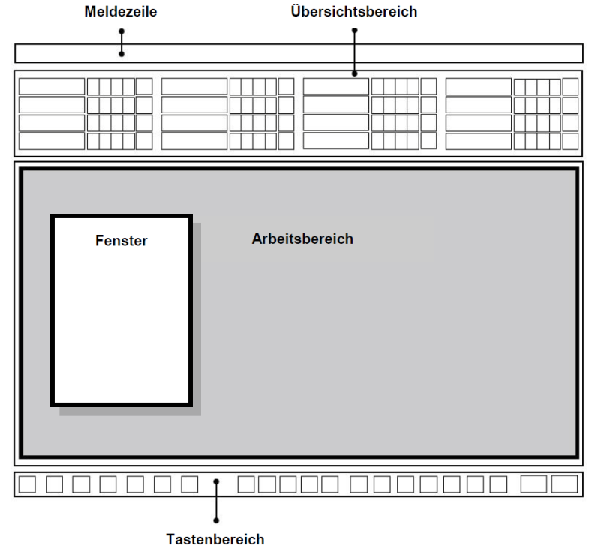
Learn-/Training Documents PCS 7 Module 2 P02-01 HMI generation
Concepts of representation
Important aspects of representation
Organization of what is to be represented
Degree of filling
Coding
Conspicuousness
Consistency
Basic structure of display area according to VDI 3699
Flowcharts
Process control flowcharts
Process flowcharts
Basic flowchart, process flowchart, P&ID flowchart
Message line
Overview area
Window
Working area
Key area
Notes:
38

Slide 39
Learn-/Training Documents PCS 7 Module 2 P02-01 HMI generation
HMI generation in PCS 7
Picture hierarchy can be derived directly from plant hierarchy
Creating a picture in the corresponding levels
Using the block icons of templates
Deriving block icons from the plant hierarchy
Configuring different OS areas
For example, unit T1 is monitored by operator 1, T2 to T4 by operator 2
Monitor configuration
Representation for different resolutions, numbers and arrangement of monitors
Graphics Designer
Drawing the process pictures (static elements)
Linking dynamic elements with the process tags
Notes:
39

Slide 40
Learn-/Training Documents PCS 7 Module 2 P02-01 HMI generation
Graphics of the laboratory plant
Hierarchy includes level 1 and 2
Overview screen
Displays all units
Displays the most important information
Abstract
Area display
Display of a unit
Display of faceplate icons of motors and valves
Display resembling the P&ID
Notes:
40

Slide 41
Learn-/Training Documents PCS 7 Module 2 P02-02 Alarm engineering
Objectives
Theory
Message systems
Alarms and messages
Alarm management in PCS 7
Step-by-step instruction
Integration of monitoring and alarm blocks
Message system of WinCC
Display of alarms and warnings in the operator station (OS)
Notes:
41

Slide 42
Learn-/Training Documents PCS 7 Module 2 P02-02 Alarm engineering
Message system, alarms and messages
Interface between process and operator
Early detection of deviations from the desired state
Specific interventions to restore the desired state
Alarm display or report of occurrence of an event that requires immediate action of the operator
Message display or report of occurrence of an event that requires no immediate action of the operator
Properties for selection of alarms
Relevant
Unambiguous
Timely
Prioritized
Comprehensible
Priority
Response time | Potential effect
 | Plant shutdown | Loss of production | Delay in production
< 5 min | High | Medium | Low
5 - 20 min | Medium | Low | Low
> 20 min | Low | Low | Low
Priority
Notes:
42

Slide 43
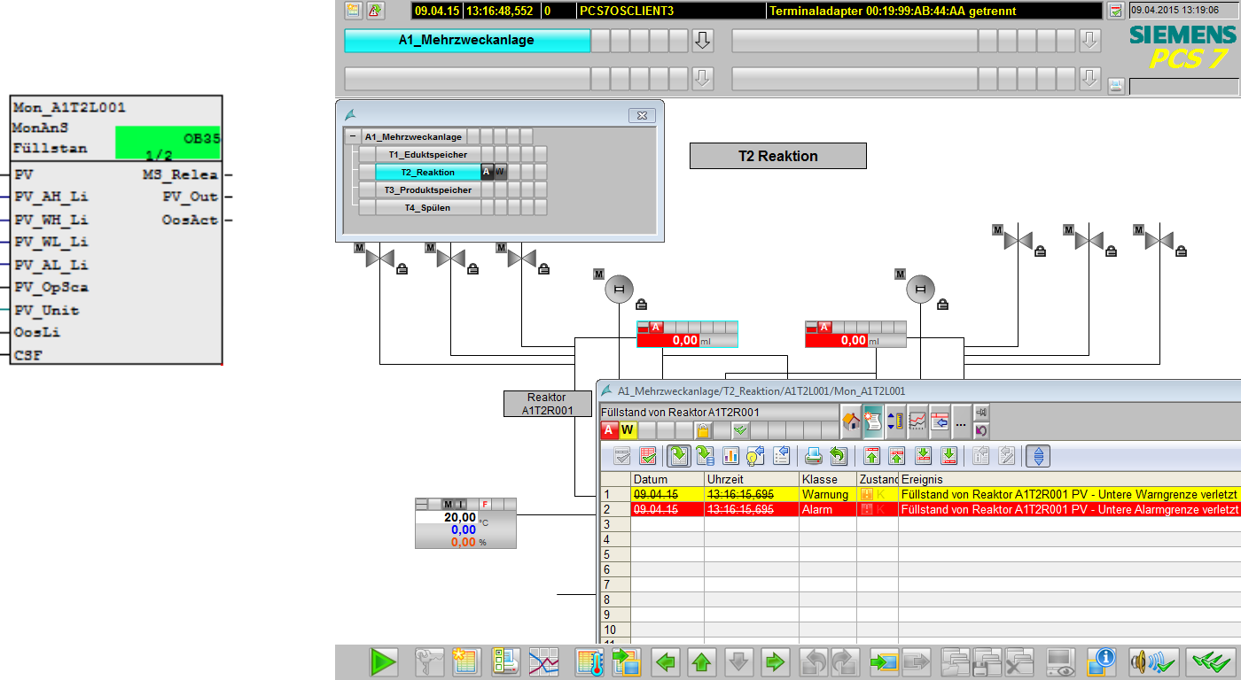
Learn-/Training Documents PCS 7 Module 2 P02-02 Alarm engineering
Alarm management in PCS 7
Function block for generating messages
Block icons for display of alarm states
Group alarms along the plant hierarchy
Display and management of message lists
Notes:
43

Slide 44
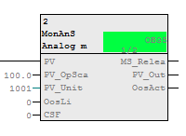
Learn-/Training Documents PCS 7 Module 2 P02-02 Alarm engineering
Alarms for the laboratory plant
Monitoring of level
Monitoring of temperature
Using MonAnS block (FB 1912) from Monitor folder of the PCS 7 Advanced Process Library V80
Monitoring a measured value (analog signal)
Adjustable parameters
Warning limit (high/low)
Alarm limit (high/low)
Display of faceplate icon
In unit T2_reaction
Positioning and compiling
Notes:
44
To Do

Slide 45
Learn-/Training Documents PCS 7 Module 2 P02-03 Archiving and trend reporting
Objectives
Theory
Goals of archiving
Archiving on the OS server
Short-term and long-term archiving
Trend reporting
Step-by-step instruction
Activating archiving in CFC
Archive settings of the OS server
Trend groups and reports
Notes:
45

Slide 46
Learn-/Training Documents PCS 7 Module 2 P02-03 Archiving and trend reporting
Goals of archiving
Why must process data and events be saved?
Legal requirements: logging of faults, verification for compliance with requirements, gapless tracking of the production cycle for product liability purposes
Process management: statistics of production data, optimization of production, increasing of performance, optimization of material and manufacturing costs
Safety: analysis of production data for adapting production parameters, in particular limits and response times, verification of functional safety when testing interlocks and EMERGENCY OFF functions
Performance: increasing of performance of the process database, data backup
Notes:
46

Slide 47
Learn-/Training Documents PCS 7 Module 2 P02-03 Archiving and trend reporting
Archiving on the OS server
Archiving on the OS server = short-term archiving
Process values
Slow cycle Tag logging slow
Fast cycle Tag logging fast
Messages/events Alarm logging
Structure of the archives (Tag logging slow/fast, Alarm logging)
Circular archive consisting of segments
30 bytes/value
Memory on the OS serve
max. 30 bytes/value
200 to 400 bytes/message
current segment
full segments
Notes:
47

Slide 48
Learn-/Training Documents PCS 7 Module 2 P02-03 Archiving and trend reporting
Short-term and long-term archiving
Short-term archiving on the OS servers
Long-term archiving on a Central Archive Server
Process values archive slow archive fast
Messages/events message archive
Charge reports, OS reports report archive
Central Archive Server (CAS) gathers data for long-term archiving from multiple OS servers and Batch servers
CAS can be configured redundantly for increased data security
CAS has no connection to the automation system
OS clients
Terminal bus
OS server (redundant)
Batch server (redundant)
Central Archive Server (CAS)
Plant bus
Automation systems
Notes:
48

Slide 49
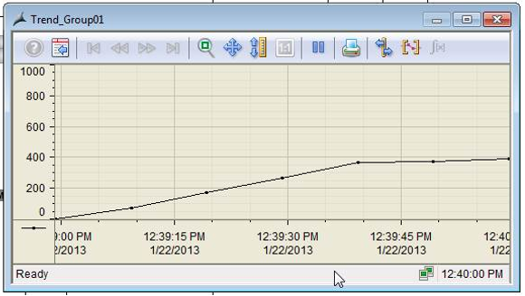
Learn-/Training Documents PCS 7 Module 2 P02-03 Archiving and trend reporting
Trend reporting
Trend reporting = Representation of process values in curves (i.e. graphical representation of process values over time)
Possible representations in PCS 7
Trend groups
Online Trend Control
Online Function Control (deviates from the definition of trends but displays process values depending on other process values)
Representation of archive tags by accessing the archives on the OS server
Representation of online tags by buffering the current process values
Useful for process values that are not archived
Buffering only as long as the display is shown
Notes:
49

Slide 50
Learn-/Training Documents PCS 7 Benefits
Theoretical and practical introduction to process control engineering of a process plant – in general and with PCS 7 at the university level
Guided implementation based on available projects or implementation of your own designs possible
Testing the implementation in a simulated plant

Slide 51
Learn-/Training Documents PCS 7 Outlook
As a lecture (= theory) with practice (= exercises) to design a solution and to implement the design in PCS 7
As practical training (= exercises) to design a solution and to implement the design in PCS 7
or
As self-study to implement projects with PCS 7
Use of the documents in training/education

Slide 52
Thank you for your attention!
Siemens Automation Cooperates with Education
Subject to changes and errors. The information given in this document only contains general descriptions and/or performance features which may not always specifically reflect those described, or which may undergo modification in the course of further development of the products. The requested performance features are binding only when they are expressly agreed upon in the concluded contract.
All product designations, product names, etc. may contain trademarks or other rights of Siemens, its affiliated companies or third parties. Their unauthorized use may infringe on the rights of the respective owner.
siemens.com/sce

