Slide 1
PA University Curriculums for SIMATIC PCS 7
Siemens Automation Cooperates with Education | 09/2015

Slide 2
PA University Curriculums Contents
MODULE 1
P01-01 Process description
P01-02 Hardware configuration
P01-03 Plant hierarchy
P01-04 Individual drive functions
P01-05 Functional safety
P01-06 Control loop and other control functions
P01-07 Importing plant design data
P01-08 Sequential function charts
P02-01 HMI generation
P02-02 Alarm engineering
P02-03 Archiving
MODULE 2
Notes:
2

Slide 3
PA University Curriculums Module 1 P01-01 Process description
Objectives
Categorization of process cells
P&ID of the laboratory process cell
Locks and recipes for the laboratory process cell
Notes:
3

Slide 4
PA University Curriculums Module 1 P01-01 Process description
Classification of process control systems
Classification by the number of basically different products
Single product process cell
Multi product process cell
Classification according to the physical structure of the process cell
Single-line process cell
Multi-line process cell
Multi-line & multi-path process cell
Laboratory process cell as learning example
Multi product, multi-line & multi-path process cell
Hierarchical breakdown into 4 units
Notes:
4

Slide 5
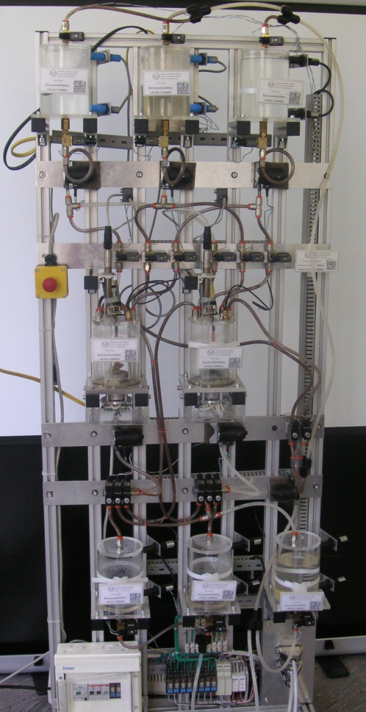
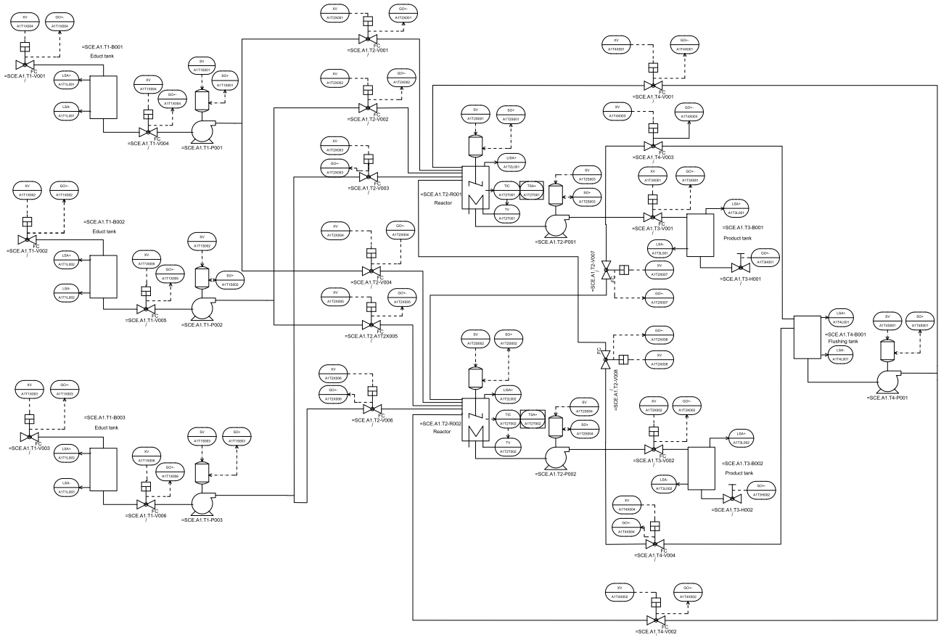
PA University Curriculums Module 1 P01-01 Process description
P&ID of the laboratory process cell
Product tanks
Rinsing
Reaction
Educt tanks
Notes:
5

Slide 6
PA University Curriculums Module 1 P01-01 Process description
Locks and recipes
Safe operation of the process cell needs monitoring of interactions with the process
Requirements for the laboratory process cell:
Activation of actuators only when the main power switch is on and EMERGENCY OFF is unlocked
Protection of the tanks against overflow
Prevent the intake of air at the pumps
Pumps must not work against closed valves
…
Manufacturing of a product needs a recipe
Recipe of the laboratory process cell:
350 ml of educt 3 to reactor 1 and 200 ml of educt 1 to reactor 2
Heating of reactor 1 up to 25 °C and 150 ml of educt 2 to reactor 2
…
Notes:
6

Slide 7
PA University Curriculums Module 1 P01-02 Hardware configuration
Objectives
Theory
Distributed structures
Connection to the process
Operating principle of a programmable logic controller (PLC)
Step-by-step instruction
Creating new projects
Configuring the hardware
Configuring the communication network
Notes:
7

Slide 8
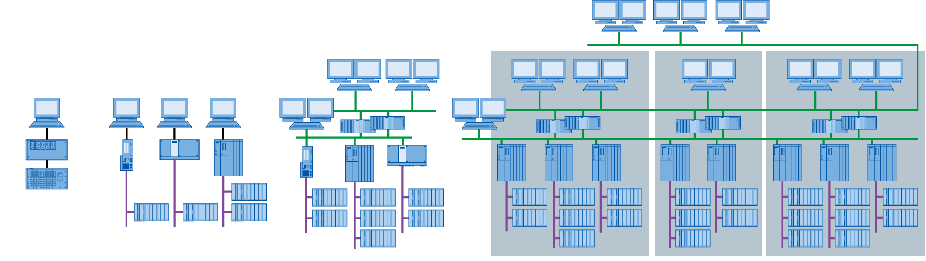
PA University Curriculums Module 1 P01-02 Hardware configuration
Distributed structures of process control systems
Special structures lead to scalable process control systems
Structures are component based and can be easily expanded
Typical structure:
Process control level
Control level
Field level
Laboratory
Test center
Production plant
Connected facilities at one production site
SIMATIC PCS 7 LAB
SIMATIC PCS 7: 100 to 120 000 I/Os
Notes:
8

Slide 9
PA University Curriculums Module 1 P01-02 Hardware configuration
Connection to the process
Two typical ways to connect sensors and actuators to the process control system
Directly by bus system (intelligent devices)
To signal modules over standard electrical signal
Signal modules for
Binary signals: DI/DO modules (DI .. digital input, DO .. digital output)
1 bit of memory required per signal
Analog signals: AI/AO modules (AI .. analog input, AO .. analog output)
16 bits of memory required per signal
Resolution can still be less, for example, 12 bits
Notes:
9

Slide 10
PA University Curriculums Module 1 P01-02 Hardware configuration
Operating principle of the PLC
Component on control level typically is a PLC
Input and output signals are read and written cyclically and buffered in the process image
Consistency of signals during program processing by accessing process image
Outputs
Initialization
Process image outputs
Inputs
Read the inputs
Process image inputs
Processing of operations of program blocks
Typical processing times:
1µs Bit operations 2µs Word operations
12µs Timer/counter operation 3µs Fixed-point addition
50µs Floating-point addition
Outputs
Writing the outputs
Process image outputs
Legend:
Access to hardware
Access to process image
Processing sequence
Notes:
10

Slide 11
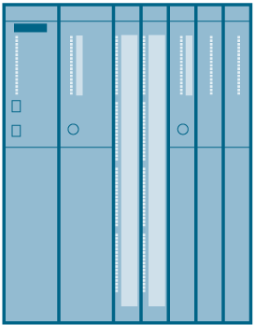
PA University Curriculums Module 1 P01-02 Hardware configuration
Hardware configuration of the laboratory plant
AS
PS
CPU (with PROFIBUS)
ET200M (with PROFIBUS)
7x DI
3x DO
1x AI
1x AO
CP (with Ethernet)
ES/OS
PC (with Ethernet)
PC station as ES and OS with PCS7 software and WinCC for visualiuation
Ethernet connection
S7 station as AS (here: CPU414-3DP)
PROFIBUS DP
ET 200M for I/O coupling
Notes:
11

Slide 12
PA University Curriculums Module 1 P01-03 Plant hierarchy
Objectives
Theory
Structuring the laboratory process cell
Deriving the visualization
Plant View and structure of visualization
Step-by-step instruction
Opening plant view
Creating plant hierarchy
Basic settings of the plant hierarchy
Notes:
12

Slide 13
PA University Curriculums for SIMATIC PCS 7 Module 1 P01-03 Plant hierarchy
Structuring the laboratory process cell
Structuring using the functional aspect
Hierarchical breakdown into units
Unit 1: educt tanks
Unit 2: reaction
Unit 3: product tanks
Unit 4: rinsing
Design of a labeling system according to ISA-88
Process cell: A1
Unit: T1 .. T4
Equipment module: B001, …, B003, R001, …
Control module: pump, valve, level, agitator, …
Notes:
13

Slide 14
PA University Curriculums for SIMATIC PCS 7 Module 1 P01-03 Plant hierarchy
Deriving the visualization
Deriving the visualization in the operator system (OS) through the following steps:
Structuring the laboratory process cell
Creating the plant hierarchy
Selection of a hierarchy level as OS area
Running the generating process (see P02-01 HMI generation)
All hierarchy levels below the level defined as OS area can be displayed automatically
Area labeling
Navigation hierarchy
Operating icons for implemented function blocks
Group alarms
Notes:
14

Slide 15
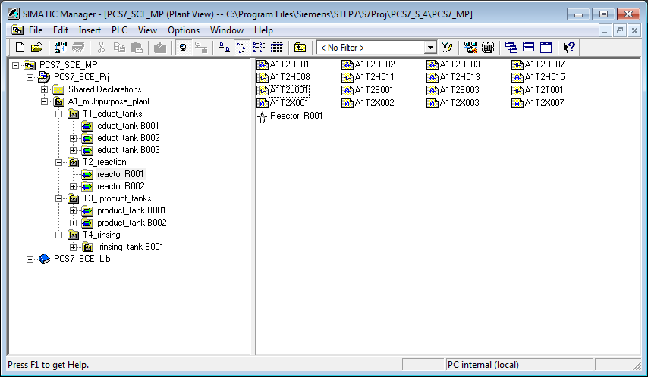
PA University Curriculums Module 1 P01-03 Plant hierarchy
Plant hierarchy and the effect on visualization
A1_multipurpose plant
OS area
T1_educt tanks
T2_reaction
T3_product tanks
T4_rinsing
Educt tank B001
Educt tank B002
Educt tank B003
Reactor R001
Reactor R002
Product tank B001
Product tank B002
Rinsing tank B001
Operating screens
Notes:
15

Slide 16
PA University Curriculums Module 1 P01-04 Individual drive functions
Objectives
Theory
Terminology of individual drive functions (IDF)
Individual drive functions in PCS 7
Individual drive function Motor
Step-by-step instruction
Creating symbol tables
Creating CFC for IDF Motor
Testing the IDF
Notes:
16

Slide 17
PA University Curriculums Module 1 P01-04 Individual drive functions
Individual drive functions (IDF)
Hierarchical structuring of the plant according to DIN EN 61512
Level 0: Control module
Control module is a frequently used component
Project wide
For more than one project
Reusing possible
Advantages:
Parameterization instead of programming
Tested functionality
Consistent handling and visualization
Classification of control modules
e. g. motor, valve, …
Enterprise
may contain
Site
may contain
Area
may contain
Process cell
must contain
Unit
may contain
Equipment module
may contain
may contain
Control module
may contain
Notes:
17

Slide 18
PA University Curriculums for SIMATIC PCS 7 Module 1 P01-04 Individual drive function
Individual drive functions in PCS 7
Function blocks as object-oriented model of an equipment module
e. g. motors and valves
Functions:
Control and control mode
Protection and monitoring functions
Operator control and visualization functions
Messaging and alarm functions
Function blocks as object-oriented model of a (measuring) signal
e.g. digital output, digital input, analog output, analog input
Functions:
Scaling the digital value to the physical value range
Monitoring the signal quality
Notes:
18

Slide 19
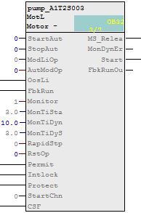
PA University Curriculums Module 1 P01-04 Individual drive functions
Individual drive function Motor_Lean (PCS 7 Advanced Process Library)
Function block MotL
Used for controlling pumps and stirrers in the laboratory process cell
Properties:
Control with one control signal (on/off)
Monitoring function through running feedback
Advantages:
No programming of the control, protection and monitoring functions
Uniform parameters
Uniform visualization (see P02-01 HMI generation)
Notes:
19

Slide 20
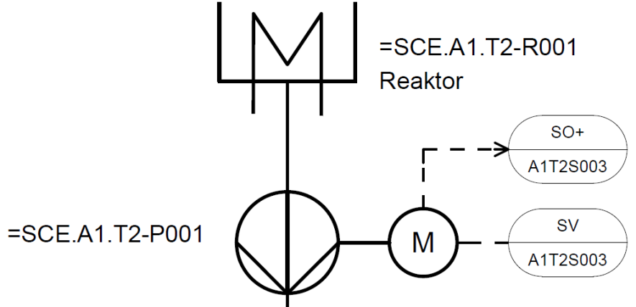
PA University Curriculums Module 1 P01-04 Individual drive functions
Implementation of a pump of the laboratory process cell
Pump SCE.A1.T2-P001 to empty the reactor
Pump is driven by a motor
The motor has the following signals
One signal for control
One signal for running feedback
Template from PCS 7 AP library
MotorLean
Reactor
Symbol | Address | Data type | Symbol comment
A1.T2.A1T2S003.SO+.O+ | I 1.3 | BOOL | pump outlet reactor R001 feedback running on
A1.T2.A1T2S003.SV.C | O 3.4 | BOOL | pump outlet reactor R001 actuating signal
Notes:
20

Slide 21
PA University Curriculums Module 1 P01-05 Functional safety
Objectives
Theory
Plant protection by the means of process control engineering (PCE)
Standardized circuit for plant protection
Design of a lock for the laboratory process cell
Step-by-step instruction
Creating CFC for manual operation of the motor
Complete lock for motor in CFC
Interconnections between CFCs
Notes:
21

Slide 22
PA University Curriculums Module 1 P01-05 Functional safety
Functional safety by means of process control engineering
Protection of process cell against failure states
In reference to the process variables, there are 3 value ranges
process value
Curve 1
Curve 2
Curve 3
Non-PCT protective device is activated
Event preventing PCT protective device is activated
Usage to non- intended purpose
Non-permissible deviation
Permissible deviation
Limit of protective equipment
Process caused limit
Usage to intended purpose
Limit of monitoring equipment
Acceptance region
PCT monitoring device is activated
time
Notes:
22

Slide 23
PA University Curriculums Module 1 P01-05 Functional safety
Design of a lock for the pump of the laboratory process cell
The pump may only be turned on when the main switch of the process cell is switched on and the emergency stop switch is unlocked
The pump must not take in air, which means the level of the reactor has to be at least 50 ml
The pump must not work against closed valves, which means at least one valve has to be open
Symbol | Address | Data type | Symbol comment
A1.A1H001.HS+-.START | I 0.0 | BOOL | Switch on main power switch
A1.A1H002.HS+-.OFF | I 0.1 | BOOL | Activate EMERGENCY OFF
A1.T2.A1T2L001.LISA+.M | IW 72 | WORD | Actual value level reactor R001
A1.T2.A1T2X007.GO+-.O+ | I 66.3 | BOOL | Open/Closed valve … feedback signal
A1.T3.A1T3X001.GO+-.O+ | I 67.4 | BOOL | Open/Closed valve … feedback signal
A1.T4.A1T4X003.GO+-.O+ | I 68.2 | BOOL | Open/Closed valve … feedback signal
Notes:
23

Slide 24
PA University Curriculums Module 1 P01-05 Functional safety
Standardized circuits for functional safety
Replace the analog value A1.T2.A1T2L001.LISA+.M with a binary value which is the result of the comparison with 50 ml
Functional table to design the combinatorial circuit
Result using conjunctive normal form (CNF) is used to lock the pump
A1T2L001 > 50ml | A1T2X007 | A1T3X001 | A1T4X003 | LOCK
x | x | x | x | 0
x | x | x | x | 0
0 | x | x | x | 0
x | 0 | 0 | 0 | 0
1 | 1 | x | x | 1
1 | x | 1 | x | 1
1 | x | x | 1 | 1
Notes:
24

Slide 25
PA University Curriculums Module 1 P01-06 Control loop, other control functions
Objectives
Theory
Structure of a control loop
PID controller
Temperature control of the laboratory process cell
Step-by-step instruction
Parameterization of a continuous controller
Output of the analog manipulated variable as a binary signal with a pulse generator
Notes:
25

Slide 26
PA University Curriculums Module 1 P01-06 Control loop, other control functions
Structure of a control loop
Process variables have to keep or achieve certain values
Disturbance behavior: A certain value has to be kept in spite of disturbances
Response to setpoint changes: Setpoint shall be achieved stable and dynamic
Control loop works as follows:
Process variable is measured by sensor
Setpoint minus measured value calculates the system deviation
Controller calculates the manipulated variable of the actuator as a function of the deviation
Actuator has impact on the system
Disturbance variables z
(System) deviation e
Manipulated variable y
Process variable = controlled variable x
Loop controller
System
Setpoint w
+
-
Notes:
26

Slide 27
PA University Curriculums Module 1 P01-06 Control loop, other control functions
PID controller
Control algorithm calculates the manipulated variable as a function of the deviation
Process industry uses the PID algorithm to 95%
P means proportional
Current manipulated variable only depends on current deviation
I means integral
Current manipulated variable depends on the sum of the last deviation values
D means differential
Current manipulated variable depends on the changes in the deviation value
Adjusting only three parameters (gain, reset time and derivative time)
Practical adjusting rules exists for systems without dominant dead times
Ziegler and Nichols method
Chien, Hrones and Reswick
Notes:
27

Slide 28
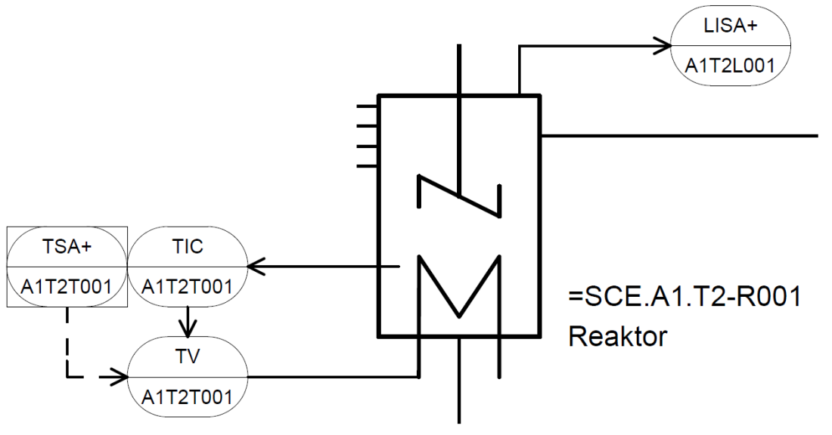
PA University Curriculums Module 1 P01-06 Control loop, other control functions
Temperature control of the laboratory process cell
Control loop
Process variable is A1.T2.A1T2T001.TIC.M
Manipulated variable is A1.T2.A1T2T001.TV.S
Setpoint is
Determined by recipe
Determined by operator
Locked
Conditions for locking
Level in the reactor has to be at least 200 ml
Temperature must not exceed 60°C
Notes:
28

Slide 29
PA University Curriculums Module 1 P01-07 Importing plant design data
Objectives
Theory
Design of complex systems
Process tag type
Model
Step-by-step instruction
Importing plant design data
Working with the process object view
Duplicating charts by creating process tag types/models
Notes:
29

Slide 30
PA University Curriculums Module 1 P01-07 Importing plant design data
Design of complex systems
Three general design methods
Principle of hierarchical structure
Plant hierarchy
Principle of modularization
Scope and complexity of blocks, CFC and SFC
Principle of reusing
Process tag types and models
Reuse also implies
Use of proven solutions (standards)
Central modifiability
Tested implementation
Notes:
30

Slide 31
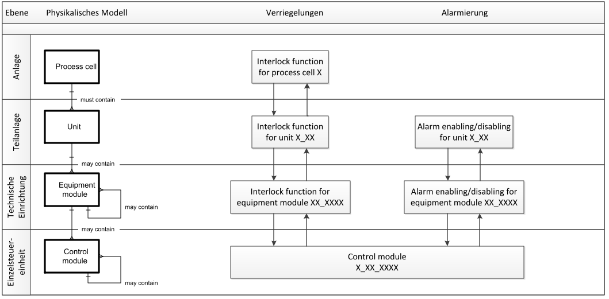
PA University Curriculums Module 1 P01-07 Importing plant design data
Process tag types and models
Process tag type (CFC) – corresponds to control module level
Model (entire hierarchy) – corresponds to equipment module or unit level
Level
Physical model
Interlock
Alarm management
Process cell
very individual
Unit
Equipment module
copying possible
for the most part
Control module
types can be created
Notes:
31

Slide 32
PA University Curriculums Module 1 P01-07 Importing plant design data
Process tag types and models of the laboratory process cell
Selecting similar control modules
Pumps
A1T1P001, A1T1P002, A1T1P003 and A1T4P001
A1T2P001 and A1T2P002
Valves
A1T1V001, A1T1V002, A1T1V003, .. , A1T1V006
...
Selecting similar equipment modules
Tanks
A1T1B001, A1T1B002 and A1T1B003
A1T2R001 and A1T2R002
A1T3B001 and A1T3B002
Notes:
32

Slide 33
PA University Curriculums Module 1 P01-08 Sequential function charts
Objective
Theory
Structure of sequential function charts
Design of a sequential control system
Recipe of the laboratory process cell
Step-by-step instruction
Creating and editing sequential function charts (SFC)
Connecting SFC and CFC
Testing the SFC
Notes:
33

Slide 34
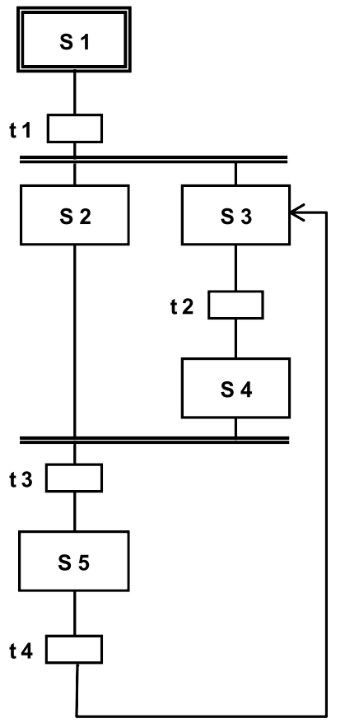
PA University Curriculums Module 1 P01-08 Sequential function charts
Structure of sequential function charts
Alternating sequence of steps and transitions
First step: start step
Final step: end step
Structures:
Unbranched sequential function chart
Alternative branches
Parallel branches
Illegal structures:
Uncertain sequence – accessibility not assured
Partial deadlock – internal infinite loop
Total deadlock – no permitted step enabling condition
One time or cyclical processing of sequential function chart is possible
Notes:
34

Slide 35
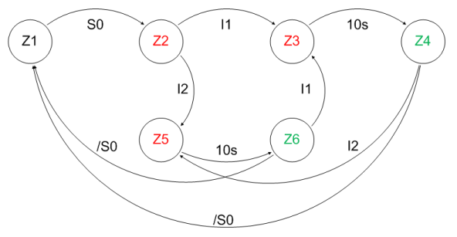
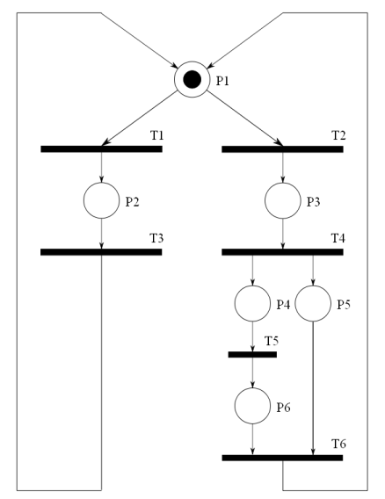
PA University Curriculums Module 1 P01-08 Sequential function charts
Design of a sequential control system
Approved design methods for sequential control systems
State transition diagram
Connected and directed graph
States shown as circle – can be linked with actions
State changes shown as arrows – can be connected to transition conditions
Petri nets
Consists of places and transitions
Places as circles
Transitions as rectangles/bars
Parallel sequences can be displayed
Notes:
35

Slide 36
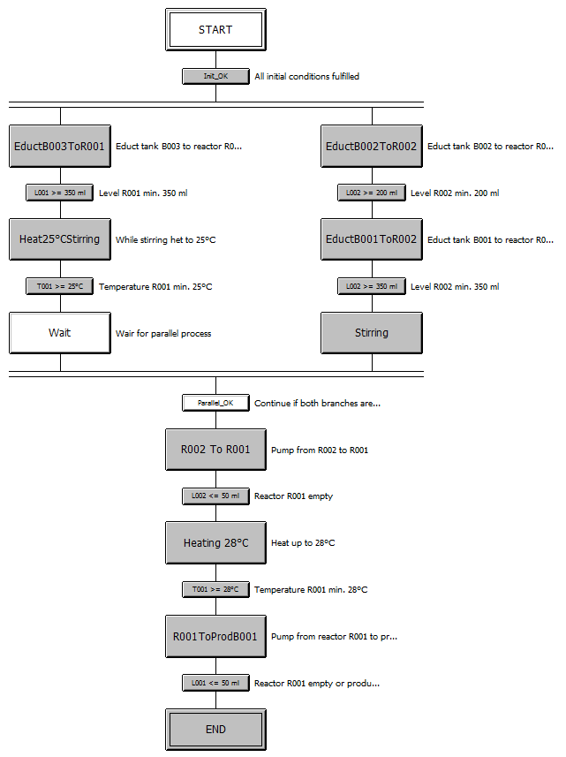
PA University Curriculums Module 1 P01-08 Sequential function charts
Recipe of the laboratory process cell
First, 350ml are to be drained from educt tank A1.T1.B003 into the reactor A1.T2.R001 and at the same time 200ml from educt tank A1.T1.B002 into the reactor A1.T2.R002.
When reactor A1.T2.R001 is filled, the liquid is to be heated to 25 °C with the agitator switched on.
When reactor A1.T2.R002 is filled, 150ml from educt tank A1.T1.B001 is to be added to reactor A1.T2.R002. When this is completed, 10s later the agitator of reactor A1.T2.R002 is to be switched on.
When the temperature of the liquid in reactor A1.T2.R001 has reached 25 °C, the mixture is to be pumped from reactor A1.T2.R002 to reactor A1.T2.R001.
Now, the mixture in reactor A1.T2.R001 is to be heated to 28 °C and then drained into product tank A1.T3.B001.
Notes:
36

Slide 37
PA University Curriculums Module 2 P02-01 HMI generation
Objectives
Theory
Concepts of visualization
HMI generation in PCS 7
HMI of the laboratory process cell
Step-by-step instruction
Generating the operator station (OS) in SIMATIC Manager
Configuration environment WinCC
Creating pictures with the Graphics Designer
Notes:
37

Slide 38
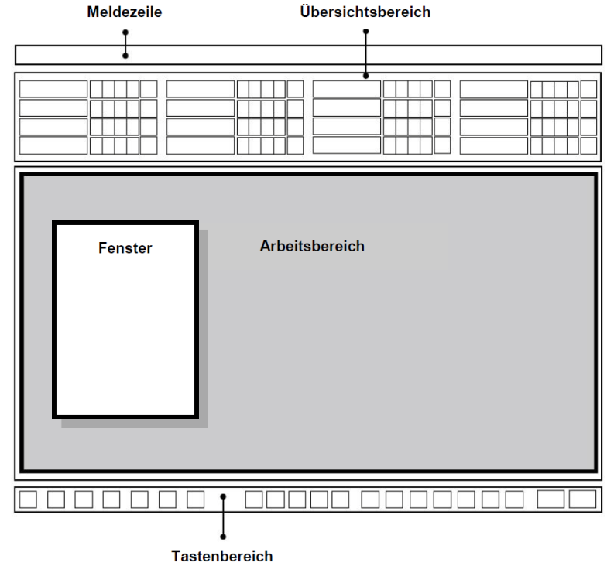
PA University Curriculums Module 2 P02-01 HMI generation
Concepts of visualization
Important aspects of visualization
Organization of visualization
Print growth
Coding
Conspicuousness
Consistency
Basic structure of display area according to VDI 3699
Flowcharts
Process control flowcharts
Process flowcharts
Basic flowchart, process flowchart, P&ID flowchart
Message line
Overview area
Window
Working area
Key area
Notes:
38

Slide 39
PA University Curriculums Module 2 P02-01 HMI generation
HMI generation in PCS 7
Picture tree can be derived directly from plant hierarchy
Creating a picture in the corresponding level
Using the block icons of templates
Deriving block icons from the plant hierarchy
Configuring different OS areas
For example, unit T1 is monitored by operator 1, T2 to T4 by operator 2
Monitor configuration
Visualization for different resolutions, numbers and arrangement of monitors
Graphics Designer
Drawing the process pictures (static elements)
Linking dynamic elements with the process variables
Notes:
39

Slide 40
PA University Curriculums Module 2 P02-01 HMI generation
Graphics of the laboratory process cell
Hierarchy includes level 1 and 2
Plant display
Displays all units
Displays the most important information
Abstract
Area display
Display of a unit
Display of faceplate icons of motors and valves
Display resembling the P&ID
Notes:
40

Slide 41
PA University Curriculums Module 2 P02-02 Alarm engineering
Objectives
Theory
Signaling systems
Alarms and messages
Alarm management in PCS 7
Step-by-step instruction
Integration of monitoring and alarm blocks
Signaling system of WinCC
Display of alarms and warnings in the operator station (OS)
Notes:
41

Slide 42
PA University Curriculums Module 2 P02-02 Alarm engineering
Signaling system, alarms and messages
Interface between process and operator
Early detection of deviations from the desired state
Specific interventions to restore the desired state
Alarm display or reporting occurrence of an event that requires immediate action of the operator
Message display or reporting occurrence of an event that requires no immediate action of the operator
Properties for selection of alarms
Relevant
Unambiguous
Timely
Prioritized
Comprehensible
Priority
Response time | Potential effect
 | Plant shutdown | Loss of production | Delay in production
< 5 min | High | Medium | Low
5 - 20 min | Medium | Low | Low
> 20 min | Low | Low | Low
Priority
Notes:
42

Slide 43
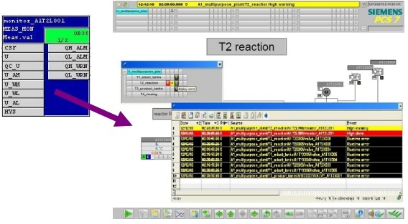
PA University Curriculums Module 2 P02-02 Alarm engineering
Alarm management in PCS 7
Function block for generating messages
Picture icons to display alarm states
Group alarms along the plant hierarchy
Display and management of message lists
Notes:
43

Slide 44
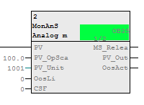
PA University Curriculums Module 2 P02-02 Alarm engineering
Alarms for the laboratory process cell
Monitoring of levels
Monitoring of temperatures
Using MonAnS block (FB 1912) from Monitor folder of the PCS 7 Advanced Process Library V80
Monitoring a measurement value (analog signal)
Adjustable parameters
Warning limit (high/low)
Alarm limit (high/low)
Display of faceplate icon
In unit T2_reaction
Positioning and compiling
Notes:
44
To Do

Slide 45
PA University Curriculums Module 2 P02-03 Archiving and Trend reporting
Objectives
Theory
Goals of archiving
Archiving on the OS server
Short-term and Long-term archiving
Trend reporting
Step-by-step instruction
Activating archiving in CFC
Archive settings of the OS server
Curves and reports
Notes:
45

Slide 46
PA University Curriculums Module 2 P02-03 Archiving and Trend reporting
Goals of archiving
Why must process data and events be logged?
Rules and regulations: logging of disturbance, verification of licensing requirements, consistent tracking of the production cycle
Process management: statistics of production data, optimization of production parameters, increasing of performance, optimization of material and manufacturing costs
Safety: analysis of production data for adapting production parameters especially limits and response time, verification of functional safety when testing interlocks and EMERGENCY OFF functions
Performance: increasing of performance of the process database, data backup
Notes:
46

Slide 47
PA University Curriculums Module 2 P02-03 Archiving and Trend reporting
Archiving on the OS server
Archiving on the OS server = short-term archiving
Process values
Slow cycle Tag logging slow
Fast cycle Tag logging fast
Messages/events Alarm logging
Structure of the archives (Tag logging slow/fast, Alarm logging)
Cycling logging consists of segments
30 bytes/value
Memory on the OS server
max. 30 bytes/value
200 to 400 bytes/message
current segment
full segments
Notes:
47

Slide 48
PA University Curriculums Module 2 P02-03 Archiving and Trend reporting
Short-term and long-term archiving
Short-term archiving on the OS servers
Long-term archiving on the Central Archive Server
Process values archive slow archive fast
Messages/events message archive
Charge reports, OS reports report archive
Central Archive Server (CAS) gathers data for long-term archiving from different OS servers and Batch servers
CAS can be configured as redundant for increased data security
CAS has no connection to the automation system
OS clients
Terminal bus
OS server (redundant)
Batch server (redundant)
Central Archive Server (CAS)
Plant bus
Automation systems
Notes:
48

Slide 49
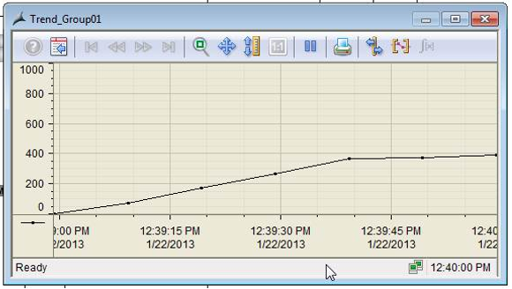
PA University Curriculums Module 2 P02-03 Archiving and Trend reporting
Trend reporting
Trend reporting = Visualization of process values in curves (which means a graphical visualization of process values in dependency of time)
Visualization options in PCS 7
Trend groups
Online Trend Control
Online Function Control (not according to the definition of trends but displays process values depending on other process values)
Visualization of archived variables by accessing the logs on the OS server
Visualization of online variables by buffering the current process values
Used for process values that are not archived
Buffering only as long as the visualization is shown
Notes:
49

Slide 50
PA University Curriculums Usage
Theoretical and practical introduction to the process control engineering of a process plant – in general and with PCS 7 at the university/college level
Guided implementation based on the available projects or implementation of your own designs
Test the implementation in a simulated plant

Slide 51
PA University Curriculums for SIMATIC PCS 7 Outlook
Use of the documents in training/education
As a lecture (= theory) with practice (= exercises) to design a solution and to implement the design in PCS 7
As practical training (= exercises) to design a solution and to implement the design in PCS 7
or
As self-study to implement projects with PCS 7

Slide 52
Thank you for your attention!
Siemens Automation Cooperates with Education
siemens.com/sce

