Slide 1

Controller HMI
Be able to develop customer-specific HMI application with watch pages
Translate the text database to allow the user to switch between languages
Controller HMI

Slide 2
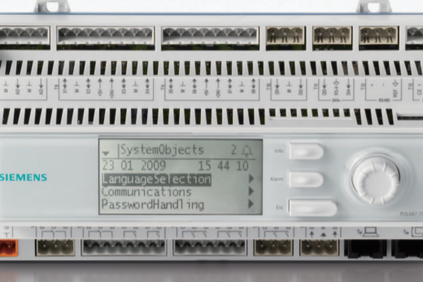
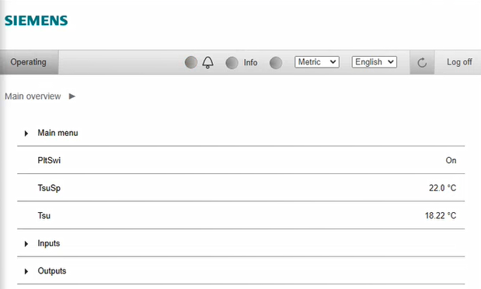

Overview of Climatix HMI
The HMI (Human Machine Interface) is needed to monitor and operate the equipment
View equipment online values
Change set points, set up scheduler
Check alarms
……
Controller built-in HMI / HMI unit
Climatix provides many options for monitoring and operation
Controller built-in HMI – on site
External HMI unit – on site
HMI on controller web server - remote
HMI on IC cloud platform – remote
Web server HMI
IC cloud HMI
Climatix allows third-party development of HMI
(not part of this training)
HMI on touch panel and mobile devices
(not in scope of this class)
Controller HMI
Depending on the user role, the menu or dedicated data (automation objects member) can be set to a security level with read or write rights. If no security level is set, all menu and data can be seen by any user.

Slide 3
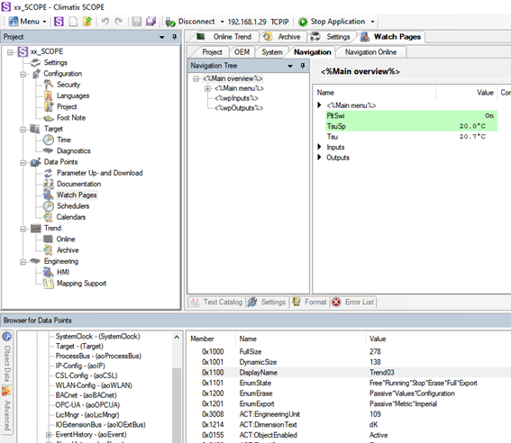
Watchpage creation flow
Language Supported Text (Text catalogue)
Application / Key ENG GER
<%Main menu%> Main Menu Hauptmenü
<%On*Off*Auto%> On*Off*Automatic Ein*Aus*Automatisch
Languages
page element
page element
The page elements can be added as plain text (hard-coded) or as translatable text (from the Languages text catalogue using the key (<%xxxx%>)
Drug and drop
the object member and translate them (mapping support)
Mapping Support
– Watch page elements
Mapping support (Object member Text)
Application ENG GER
PltSwi Plant switch Gerätemodus
TsuSp T-supply setpoint Vorlauftemperatur-Sollwert
Tsu Supply temp. Vorlauftemperatur

Slide 4
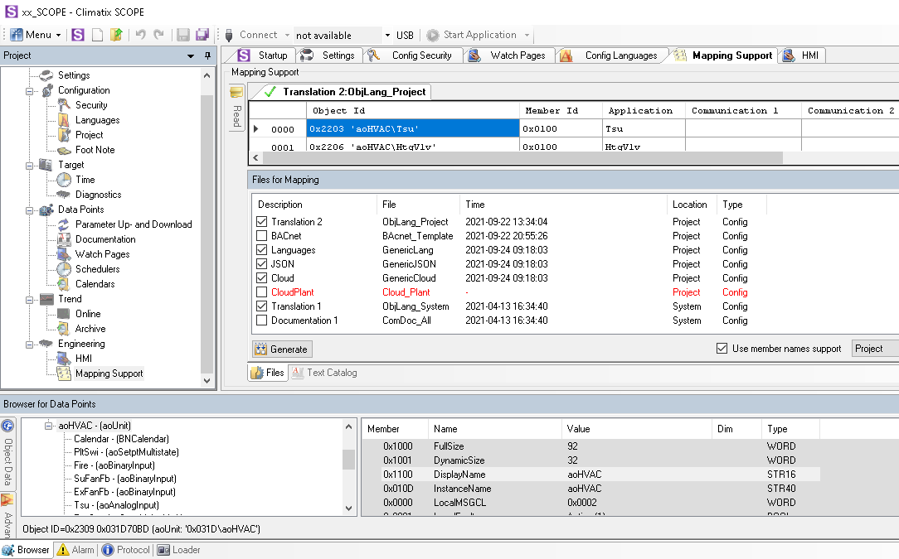

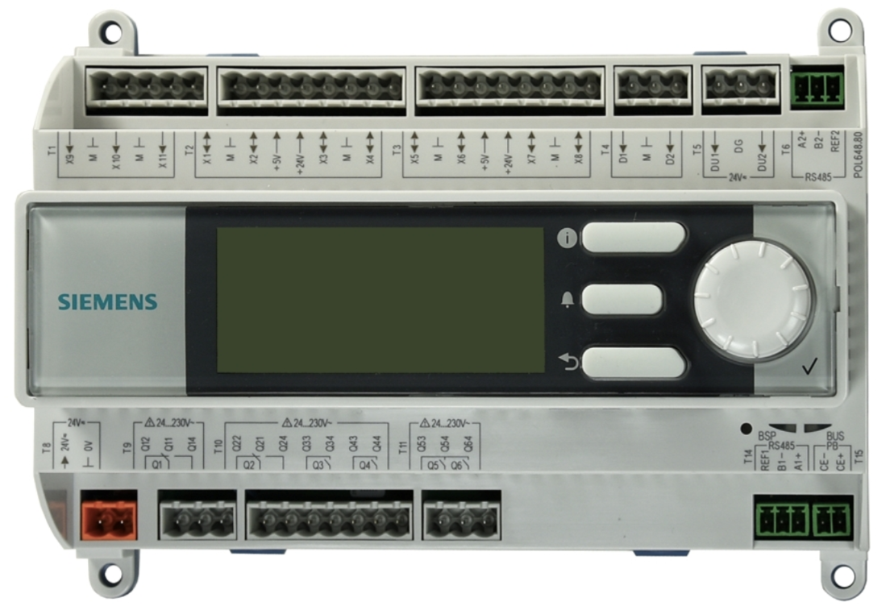
Generating downloadable files
Mapping support
Application (MBRTCode.ucf)
Mapping-Comp* (Cloud IC)
Languages supported text
Mapping support (Object text)
HMI4Web (Web server HMI)
*Communication (IC cloud)
HMI Editor
HMI-Cnf-Comp (Built-in HMI, Standalone)
– HMI file creation
* Further communication mapping (BACnet, ModBus) will be contained in this file as well when generated.

Slide 5
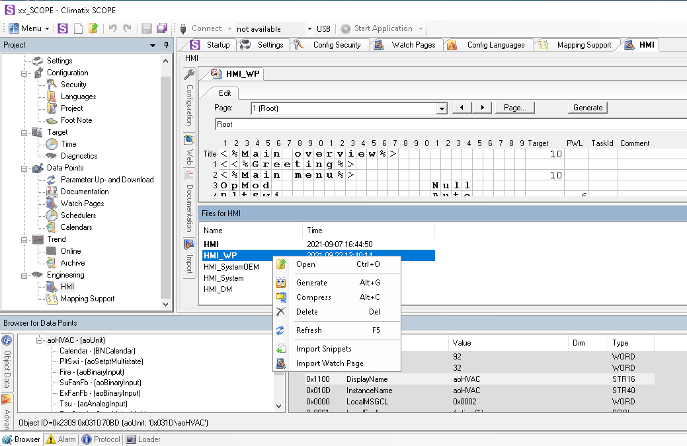
HMI Editor
– HMI file creation

Slide 6
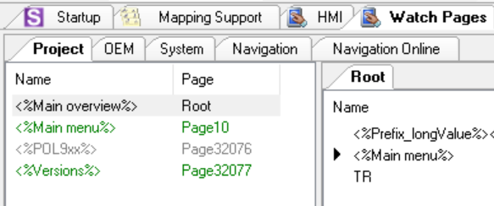
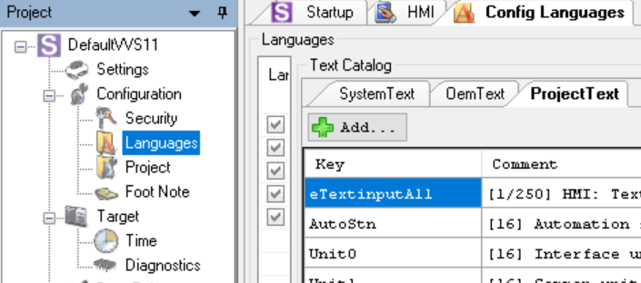
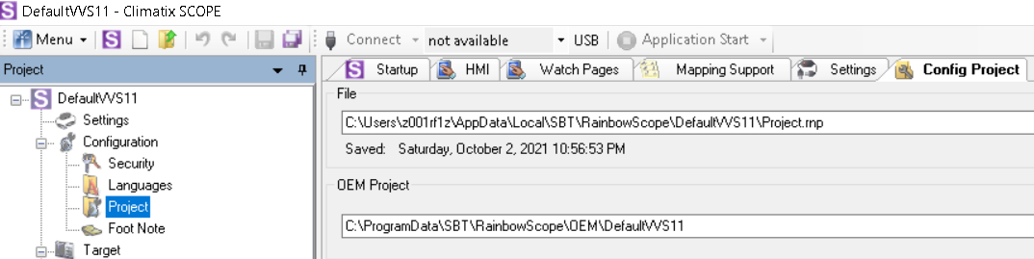
HMI Engineering Databases
HMI engineering data are stored in three databases:
System database (default): This database contains the Siemens default system template pages and texts such as alarming and diagnostic.
OEM database (optional): This database contains OEM specific template pages and texts once generated, to be shared by multiple projects, according to the setting in every SCOPE project.
Project database: This database contains project specific pages and texts from the System and OEM database.
– HMI file creation

Slide 7


Security level concept
Why are security levels needed?
Equipment is interacted by people who has different roles in the projects, from factory to site.
For certain roles, we need to limit the rights of operating and setting-up the equipment, therefore 5 security levels are available:
  Full access (0)
  Factory (2)
  Service (4)
  User (6)
  End user (253)
In Scope the security level is set while connecting to Climatix controller. When connecting with «Full access» you will see all available automation object members. All other user roles will only see the automation object members according to their rights.
Log in with full access (0)
Results of logging in with User access (?)
Log in with end user access (6)
– Security concept

Slide 8
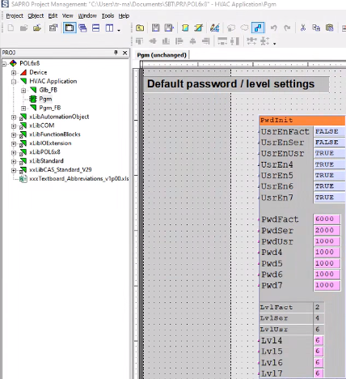
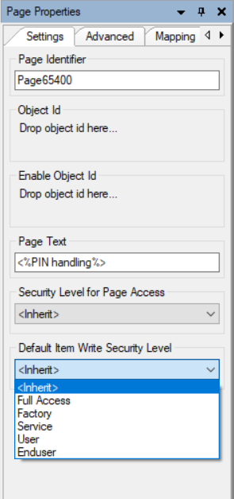
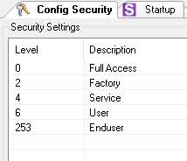
Security level settings
In SAPRO, the user roles and default passwords are predefined.
In SCOPE watch page properties, the
page and object member access (read/write) can be assigned.
– Security concept

Slide 9
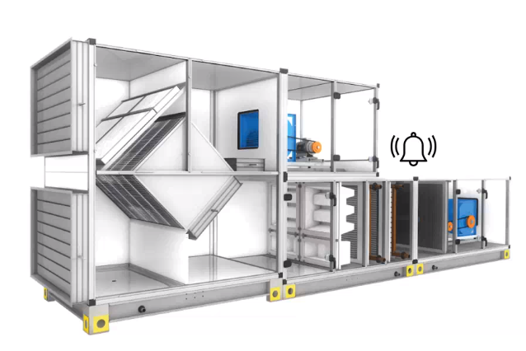
Climatix HMI watch page creation
Excercises
OK
Exercise 1. Create watch page
Learning goal:
Create watch pages with SCOPE tool, and view the results with built-in HMI
Workflow overview:
Step1. Create SCOPE engineering project
Step2. Understand template watch page
Step3. Create new page, add points to the page, create link of the page
Step4. Generate watch page, download to controller
Step5. View results on built-in HMI
Step6. (optional) Old HMI-editor
Exercise 2. Translation using text database
Learning goal:
Make use of text database to allow switching the HMI to other languages
Workflow overview:
Step1. Use text keys to enable page text translation
Step2. Add text keys to the text catalog
→ Generate mapping file and download to controller
Step3. Automation object text translation
→ Generate mapping file and download to controller
Step4. (option) Read in all unmapped objects into object text file
Fan Control
T
Plant Control
Temperature Control
Cvlv
Hvlv
TsuSP/Tsu
Controller HMI
T
T
M
M

Slide 10
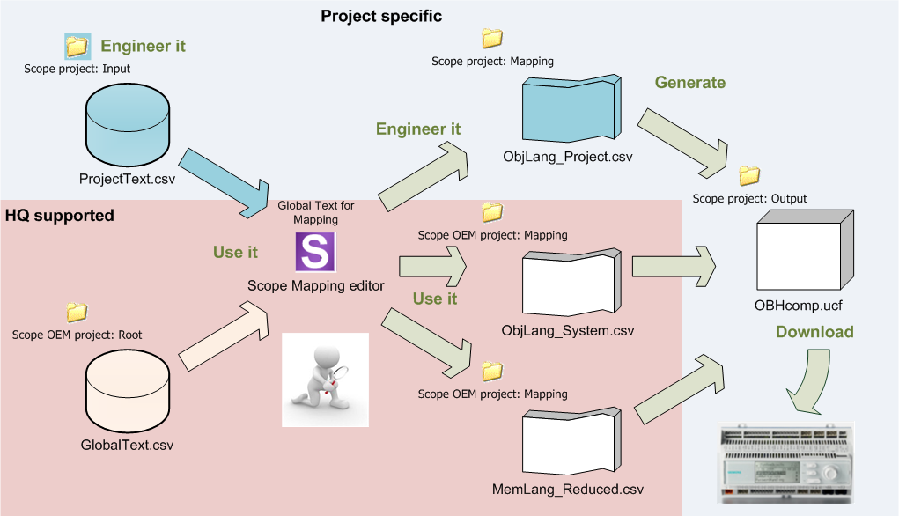
Language Support Overview Language Mapping files
Text data bank for mapping is the
translation source of the controller
mapping files to be downloaded on the controller :
ObjLang_System.csv
ObjLang_Project.csv
MemLang_System.csv / MemLang_Project.csv

Slide 11
Language Support Text data bank for translation mapping
OEM Project:
GlobalText.csv
Merge
SCOEP Project:
ProjectText.csv
Text data bank for mapping (SCOPE):
Mapping Support → Global Text tab
Each language item has a key and represents a row in GlobalText and ProjectText file
Each column represents a translation in a different language
Project specific items should be defined in the ProjectText file
In case of same Key in GlobalText and ProjectText the one in the ProjectText file is valid

Slide 12
HMI system pages
following table shows the recommended range for certain purposes:
Page Range | Use Purpose
21000 - | Input output points
32000 - | System Pages
33000 - | Communication Modules
64900 - 64909 | Enumeration Scheduler
64910 - 64919 | Setpoint Scheduler
65000 - | Alarming
65400 - | Password Handling
65500 - 65532 | Iconic Pages

