Slide 1

Trends, archives and alarms
Understand the use of online trends and being able to setup it up in the SCOPE tool
Understand the use of storing historical data in the archive and being able to set it up in the SCOPE tool
Understand the alarming concept and being able to set it up in the SAPRO tool
Trends & alarms

Slide 2
Programming basics
Introduction
Trending and Archiving Archiving - principle
Trend logs are very useful for testing, performance analysis and trouble shooting.
The SCOPE tool provides two options to analyze historical data
Online trend (Real time)
  Shows online values in a time-based profile view.
  Data can be exported to a csv File.
Trend Archive (offline values)
  is to observe and troubleshoot certain values over a longer time of period.
  It is key to optimize memory usage by setting appropriate data record frequency - fix time cycle or change of value (COV)
– Trend logging / Archive

Slide 3
Trend archive settings
Programming basics
Trending and Archiving Archiving - principle
Data log frequency setting
Cov (Change of value) → recommended
  Data is logged whenever the change is bigger than a defined threshold
  Properly setting the threshold allows important change of values being recorded, and no log is made when it is unnecessary (no change of value)
  Example: Threshold - Supply temperature 0.5° cooling valve 5%
Cycle
  Data is logged based on fixed time step
  It is easy to predict how many data will be logged for a certain time of period. Some value changes might be missed while having fixed time steps.
  Example: Outside temperature every 15 min.
– Trend logging / Archive

Slide 4
Data storage capacity for archive
Data storage in controller (internal memory)
  up to 140’000 values
  up to 64 data points (In that case, archive’s depth will be reduced to 2’200 writes per data point) per controller
  Example with 4 datapoint and fix time step – storing data each minute (60 times per minute)
  140’000 / 4 = 35000 / 60 = 583 h / 24 =24 days
  After 24 days with regards to the example the buffer settings comes into account
  Ring Buffer: when the memory is full, the oldest data starts to get erased, so that new data will have place to be stored.
  Stop When Full: when the memory is full, no new data will be logged anymore
Data storage in SD card (external memory)
  Once the feature “Export Data member” is enabled, the date is continuously written to the SD card until the SD card is full.
  More details of SD card can be found controller data sheet document
– Trend logging / Archive
Notes:
F

Slide 5
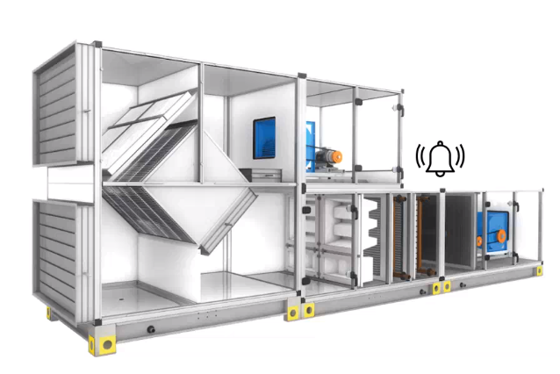
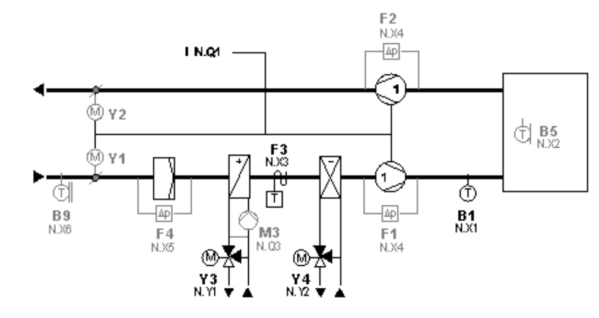
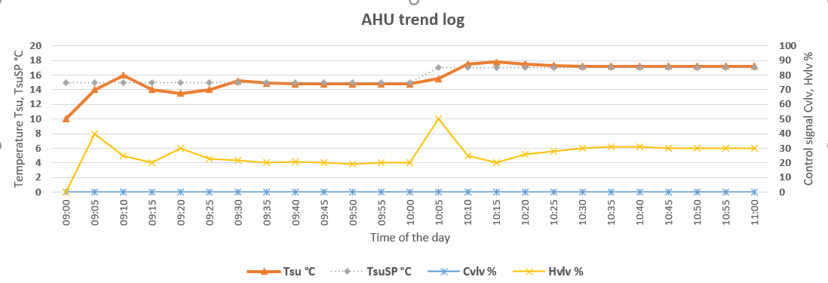
Example Application
Fan Control
T
Plant Control
Temperature Control
Cvlv
Hvlv
TsuSP/Tsu
T
T
M
M
– Trend logging / Archive

Slide 6
Climatix HMI watch page creation
Exercises
OK
Exercise 1. Create trend logging
Learning goal:
Observe, how real time value changes in the controller
Workflow overview:
Step1. add data points from the browser
Step2. adapt scales of the data points
Step3. change setpoint value and observe changes
Step4. adapt curve line setting for better differentiation
Exercise 2. Set up archive
Learning goal:
Create an archive and observe the data
Workflow overview:
Step1. enable archive
Step2. target and archive profile must be set up
Step3. Drag and drop data points to the profile viewer
Step4. Change COV settings
Step5. Configuration is registered in the target
Step6. Profile Configuration is saved in Scope project
Step7. Extend archive capacity (SD card)
Step8. Maintaining the archive
Fan Control
T
– Trend logging / Archive
Plant Control
Temperature Control
Cvlv
Hvlv
TsuSP/Tsu
T
T
M
M

Slide 7
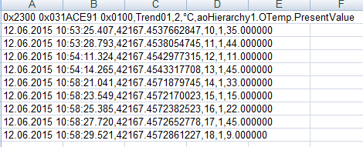
Reading the exported data
Engineering unit system enumeration: 2 = Metric, 3 = Imperial
Engineering unit system string
Object ID
Member
Trend ID
Instance Name
Line1
Line x
– Trend logging / Archive
Trend data
Date and time
(text format)
Date and time
(OLE format)
Trend entry type: 1= data, 2= state
Sequence entry number
Notes:
F

Slide 8
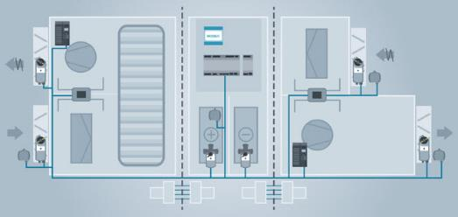





Alarming overview
    Alarming is used to indicate errors and failures in the unit and provide the appropriate actions.
    On site alarms (e.g. built-in HMI)
    Remote alarms (e.g. mobile devices, building management system, cloud)
  There are two types of events which can generate alarms:
    Fault, is related to hardware, indicates a failure within a device
      wrong signal type of inputs and outputs
      controller failure
    OffNormal, is related to application, indicates abnormal operation of the unit
      measured value (e.g. supply temperature) exceed high limit or low limit
      safety input receive active signal, such as fire and frozen
      binary output doesn’t receive correct feedback
– Alarming

Slide 9
Reasons to trigger alarms
Reason of events
Binary Output DB
Binary Output
PresentValue < > Feedback
OffNormal
OR
In Alarm
Reliability
Fault
Binary Input DB
Binary Input
PresentValue = AlarmValue
OffNormal
OR
In Alarm
Reliability
Fault
Analog Input DB
Analog Input
Present Value out of range
OffNormal
OR
– Alarming
In Alarm
Reliability
Fault
Analog Output DB
OR
Analog Output
Reliability
Fault
In Alarm

Slide 10
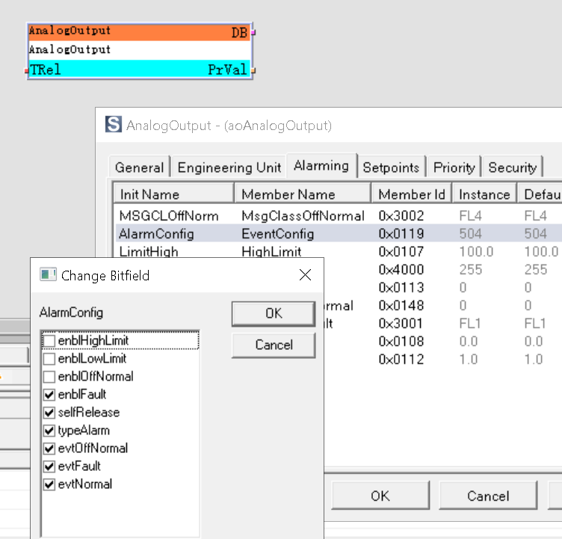
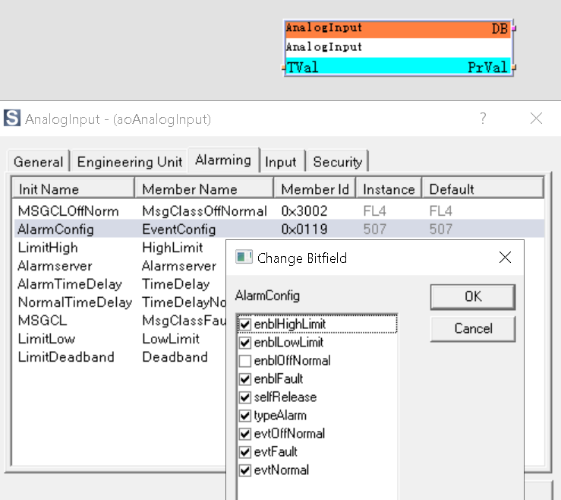
Alarm enabling settings
– Alarming
The behaviour just explained can be set individually for each automation object, by enabling or disabling the “enblOffNormal” or “enblfault” event.
  Once the tick box is selected, the event will trigger an alarm

Slide 11
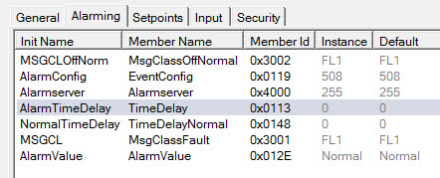
Alarm time delay settings
  Sometimes it is necessarily having a time delay between the present value and alarm generation:
      Unit start up.
      Some instability (flutter).
      Likewise, there might be a need to have a time delay between present value and alarm goes to normal.
Bad
PrVal
Good
1
– Alarming
Disbl
OffNormal = Alarm
OffNormal = Normal
OffNormal
TimeDelay
TimeDelayNormal

Slide 12
Alarm handling control logic
  What happens when the object is in alarm:
    For example, a frost signal (binary input) is received from a thermostat as “OffNormal”
    The alarm triggers certain logic in the application
    An entry is created in the controller alarm list.
    A message is received on the HMI.
    Further alarm messages can be configured to be received by external clients, e.g. SCOPE, BACnet client, SMS.
control logic
  a
  c
D1
  d
  b
  e
– Alarming

Slide 13
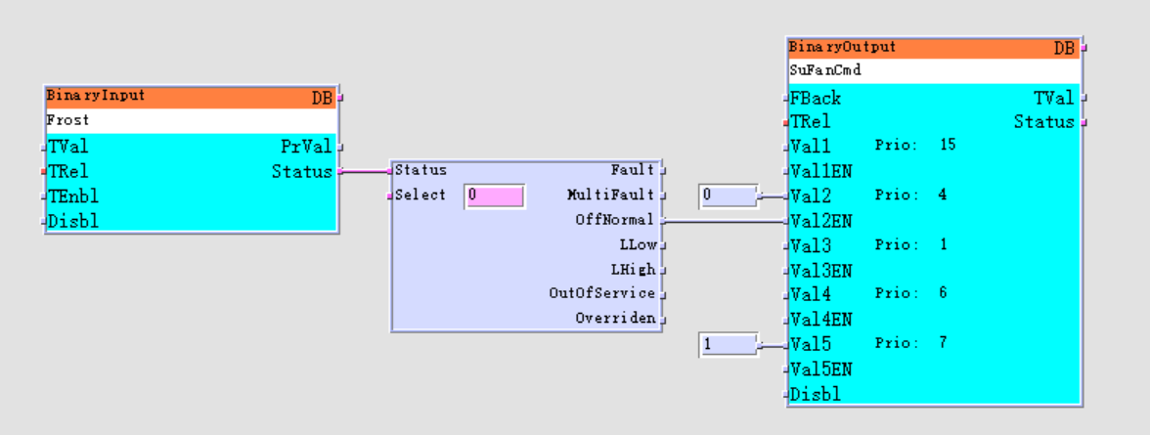
Status evaluation object
  Many automation objects support alarm functionality.
  The objects that can generate alarms have an output called “Status”.
  The “Status” output of the binary Input provides information about the actual alarm state of the object.
  The “Status Evaluation object” is used to transform the ‘Status’ signal to multiple boolean signals, in order to incorporate reactions into the application program.
Status evaluation object
– Alarming
  Addition information about select setting of ‘StatusEval’ object is to be found in technical documentation.

Slide 14
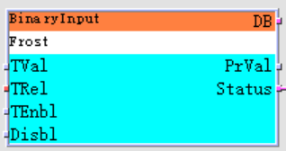
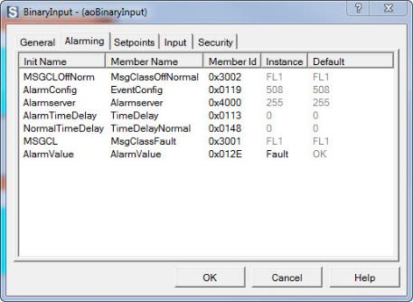
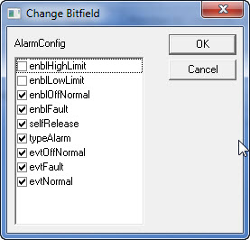
Alarm release behavior
  There are two release behaviors of alarms:
  Self release alarms – these alarms disappear automatically after the source of the alarm (event which generates alarm) is solved, normally these alarms need no acknowledge
  Not self release alarms – these alarms stay in your alarm list and the programmed reaction in the application still continues after the source of the event (event which generates alarm) is solved. These alarms need always a manual acknowledge to go back to normal.
  By default all alarms are self release, if you want to change it, use the member “EventConfig” and the ”Change Bitfield” dialog “AlarmConfig”.
– Alarming

Slide 15
Example Application
Toa
Fan Control
Plant Control
T
Temperature Control
ClgV
HtgV
TsuSP/Tsu
T
T
M
M
  Exercise 1. Binary input, fire
  Whenever the fire contact is open the binary input object generates an alarm, and the whole unit is turned off accordingly. This alarm is not self-released.
  Exercise 2. Analog input, supply temperature
  When the measured temperature value is out of high- and low-limit range, an OffNormal event is triggered which generates an alarm. Reliability issue such as sensor not connected, triggered Fault event and also generates an alarm. The alarm is self-released.
  Exercise 3. Binary output, supply and extract fan
  When the fan feedback signal is not same as fan command output, an alarm is generated and the whole unit is turned off. This alarm is not self-released.
– Alarming

Slide 16
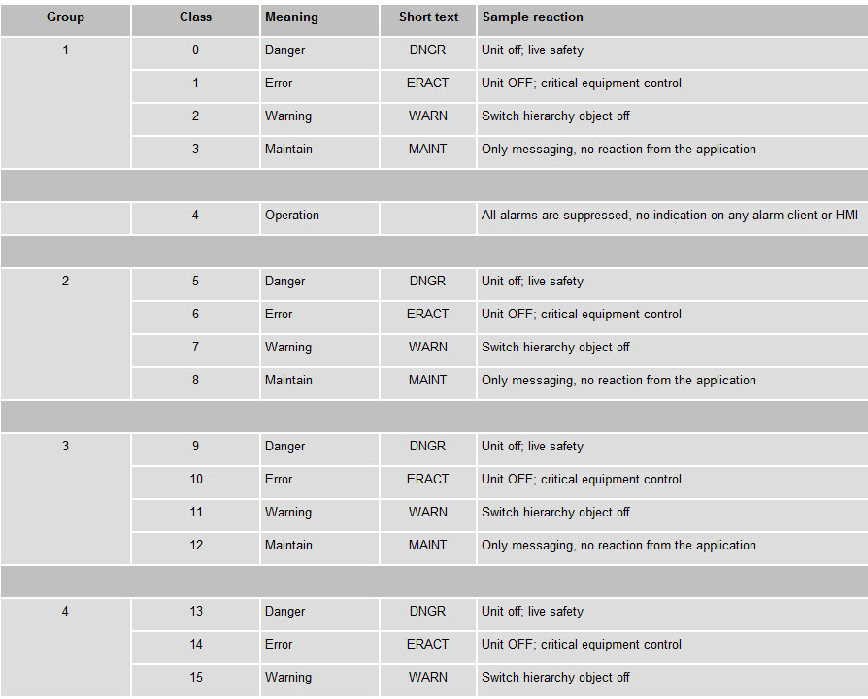
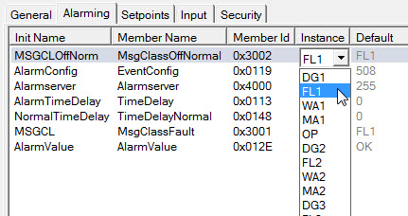
Climatix system is compliant with BACnet
  Alarm message classes are used for large projects to categorize the alarm messages for filtering and distribution purposes.
  Each object that supports alarming (OffNormal and Fault) should have the message class defined.
– Alarming
  Danger – life safety (fire)
  Error or fault – critical equipment failure
  Warning – low or high temperature
  Maintenance – filter dirty

