Slide 1

HVAC control
Become familiar with the Climatix libraries of functions including function and HVAC blocks, automation and BACnet objects.
Be able to develop own HVAC application programs
HVAC control

Slide 2
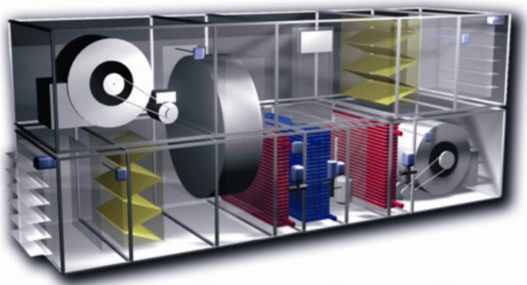
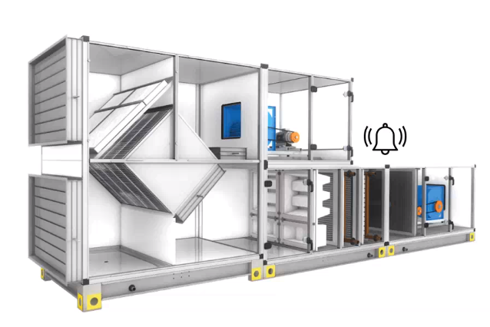
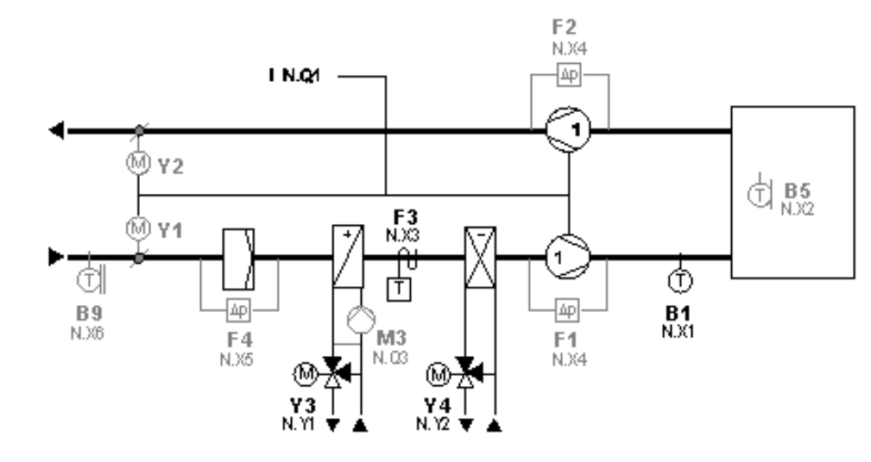
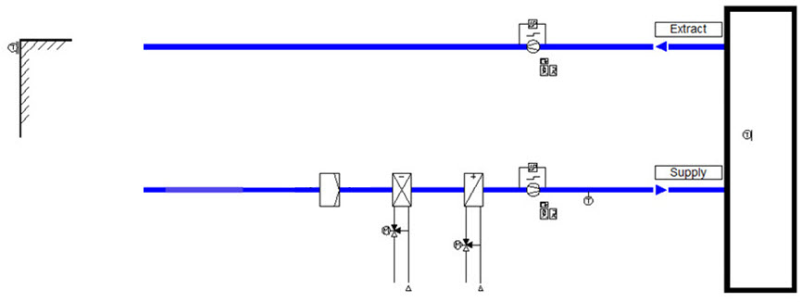
Automation Objects overview
Fan
Control
T
Plant Control
Temperature Control
T
T
HVAC control
M
M
Pgm – Level 0
Hierarchy – Level 1
Description | Type | Signal | Unit | IO
Outside air temp. | AI | Ni1000 | °C | X1
Supply air temp. | AI | Ni1000 | °C | X2
Room air temp. | AI | Ni1000 | °C | X3
Fire alarm | DI | N/O Volt free cont. | Normal,ALARM | X4
Supply fan diff. pressure switch | DI | 24VAC signal | No Flow,Flow | D1
Extract fan diff. pressure switch | DI | 24VAC signal | No Flow,Flow | D2
Supply fan command | DO | 24V Relay | Off,On | Q1
Extract fan command | DO | 24V Relay | Off,On | Q2
Cooling coil valve | AO | 0-10V | % Open | X7
Heating coil valve | AO | 0-10V | % Open | X8
aoHWIO
Type: Unit
Controller HW
XO 1
XT 1
POL 6x8
XO 2
XT 2
XO 1
XT 1
XO 3
XT 3
XO 2
XT 2
DO 1
DI 1
Type: Unit
DO 2
DI 2
aoHVAC
DO 3
DI 3
ID1
ID2
DO1
DO 10
X 10
ID3

Slide 3
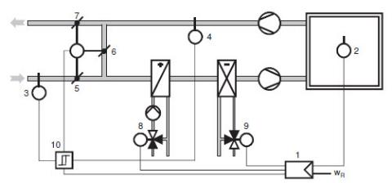
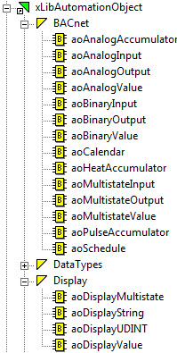
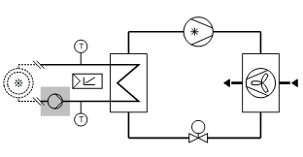
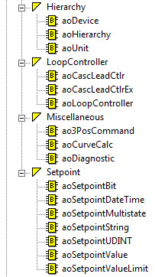
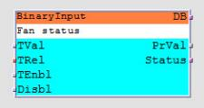
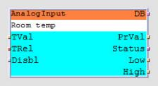
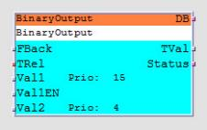

Automation Objects overview
Air handling unit (AHU)
SAPRO – Automation object library
  Automation objects represent physical and software process values of a system within a controller (e.g. temperature, switch, actuator, setpoint etc) .
  Supported function types include:
      Binary input, output, value
      Analog input, output, value
      Multistate input, output, value
  Automation objects have internal functionality that can be configured.
  They make data available to clients (e.g. SCOPE, BACnet clients). Data is stored to flash memory during power off.
  In Climatix, most Automation objects are based on the BACnet standard.
Refrigeration machine (e.g chiller)
– Automation objects
FB ‘Y’ - copy
1. Step no line only hardware
RoomSetpoint
IN d’
Of’
IN e’
Type: FBD
2. Step - line

Slide 4
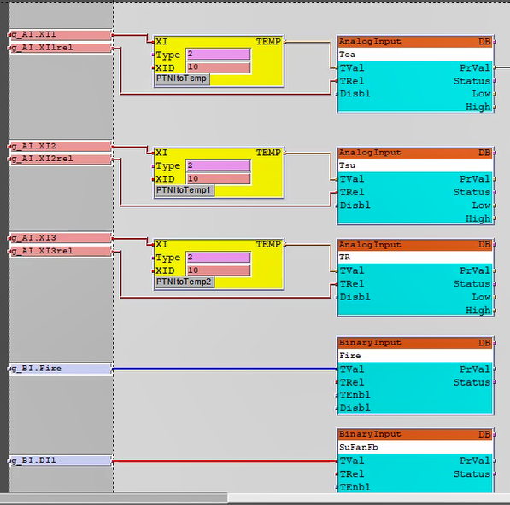
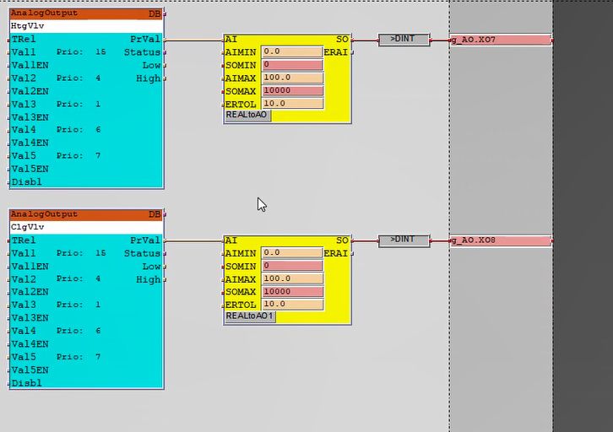
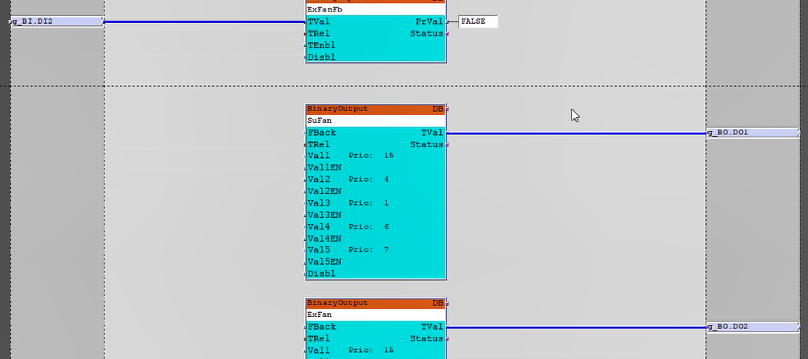
Automation Objects overview
– Automation objects

Slide 5

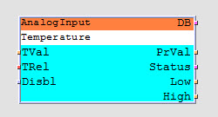
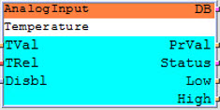


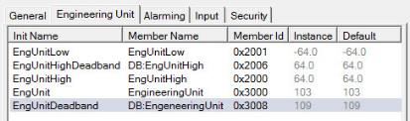
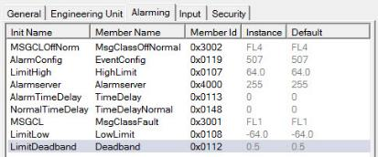
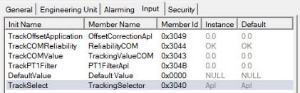

Analog input objects
Device HWIO
  Tracking (value) selector:
      Value direct from the application (default)
      Or from communications (e.g. Modbus)
Sensor
Present value
Reliability
Alarm handling
Value of low alarm
Value of high alarm
Apl
T
Stored in the Object storage
COM
Modbus
T
– Automation objects
  Apl Present value from the Application value
  COM Present value from the Communication value
  Average Present value is the average between Apl and COM
  Min Present value is the lower value of COM and Appl
  Max Present value is the higher value of COM and Appl
  PrfApl If Apl is good (Reliability ok), PrVAL is Apl, otherwise COM
  PrfCOM If COM is good (Reliability ok), PrVal is COM, otherwise Apl
Limit range of the LimitLow and LimitHigh values
Engineering unit codes
Value for high limit alarm
Value for low limit alarm
  Binary input objects also have tracking selection with AND, OR options.
Defines where and how the tracking value is determined

Slide 6
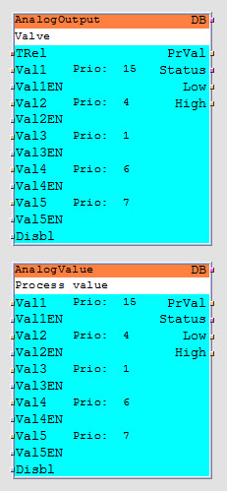
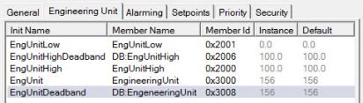
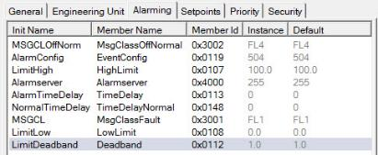

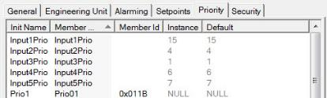
Analog output and value objects
  Analog Output objects for damper and value actuators and Analog Value objects for process values.
  Both object types have priority array inputs.
  Analog output object has a tracking value reliability input, connected to the hardware IO if available on the device.
  Engineering units must be defined (e.g. percentage %).
  Both object types support alarming.
  Default member, value of PrVal when all values in the priority array have a NULL value.
– Automation objects

Slide 7
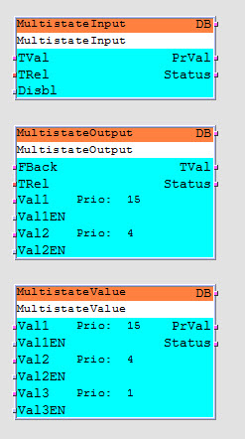

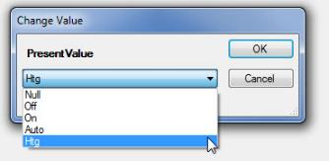

Multistate objects
  Are used to monitor and control equipment with multiple conditions, e.g. unit mode switch (Off/On/Auto), 3 speed fan (stage 1, 2, 3).
  Multistate inputs, outputs and values
  An integer value represents a specific condition defined by the engineer, e.g. 1 = Off, 2 = On, 3 = Auto, 4 = Htg.
  Status text, the BACnet standard does not allow a state = 0, in SAPRO this is allowed therefore a NULL must be used.
SCOPE
– Automation objects
SAPRO 0 1 2 3 4
Text Null Off On Auto Htg
BACnet 1 2 3 4
Status text: Null*Off*On*Auto*Htg
No. of states: 4

Slide 8
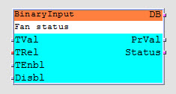
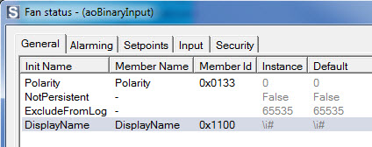
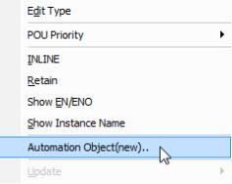
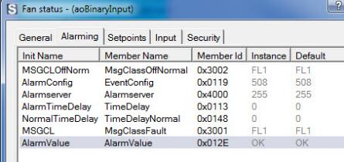
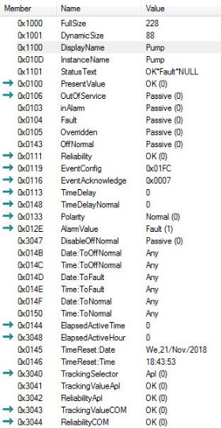
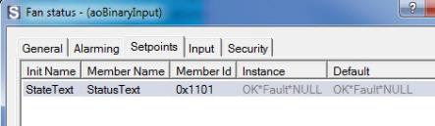
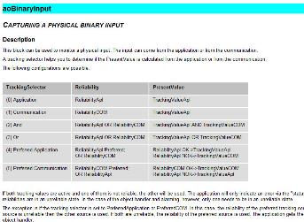
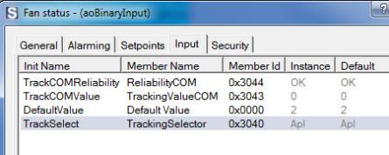
Binary input objects
  The Instance name must be unique in the application program.
  Display name used in clients like HMI and SCOPE. Default, the instance name is used, token is \i#
  Tval is the tracking value, i.e. the physical hardware input. PrVal is the present value.
  Many objects support intrinsic alarming that can be defined. The Status output is used for alarm functionality within the program. Disbl disables Offnormal alarms.
  In SAPRO, each object input, output and property is called a “Member”.
  Each member has a data format defined.
Object type name
Instance name
Connectable outputs
Connectable inputs
Curser, mouse right button click.
SCOPE
– Automation objects
Select <Automation Object (new)> to configured object.
F1 – SAPRO help

Slide 9
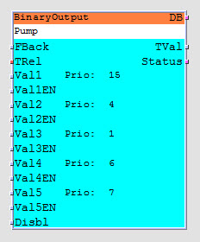
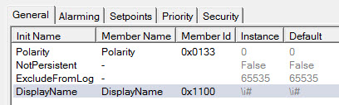
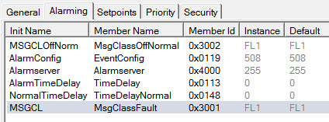
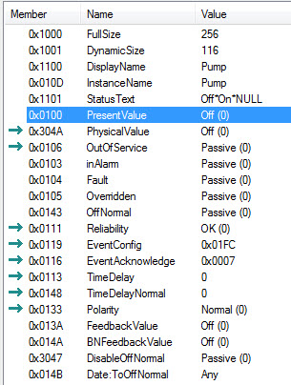

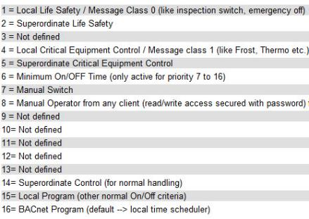
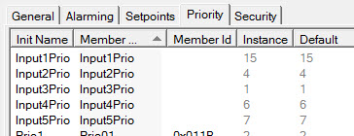
Binary output objects
  Binary output objects (digital) are used to control switching outputs for fan and pumps.
  Tval is connected to a physical output, the value is determined by the priority array.
  Fback, if there is no real feedback, connect to Tval.
  StateText, must be defined with format Off*On*Null, change text as required.
Object type name
Access to all members
Instance name
Tracking value
Used for alarming
Alarm handling
Each input has a value and enable.
5 inputs are available on the object.
Automation Object(new) - options
– Automation objects
SCOPE
Priority array – BACnet standard

Slide 10

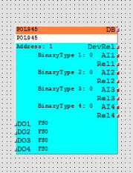
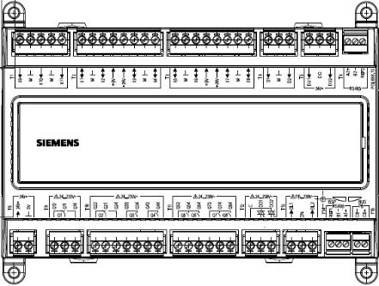
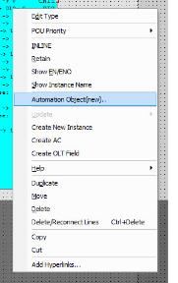
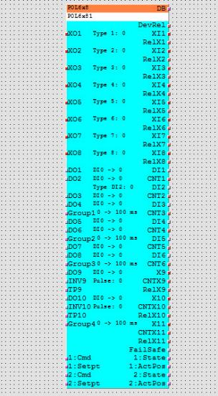
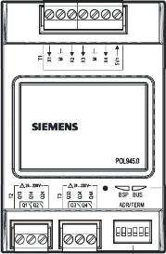
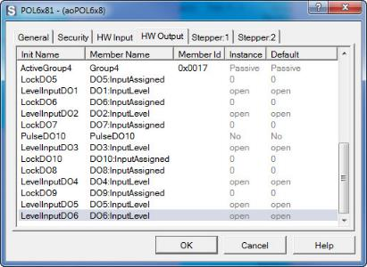
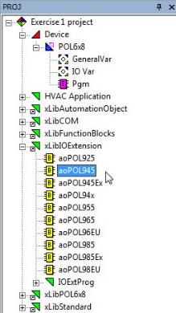
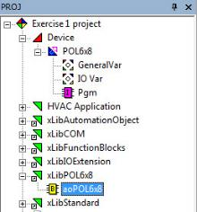
HW IO programming → Exercise 1
  For each Climatix device with physical inputs and outputs, an automation object is available. Example C600 controller.
  Function block for Climatix extension modules
POL688.10/STD controller
Hardware IO function block
Parameterized by selection the function block, right mouse click and select Automation Object(new).
– HW IO programming
SAPRO project tree – xLib….
Options for configuring the inputs and outputs

Slide 11
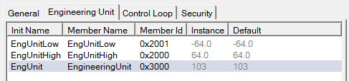
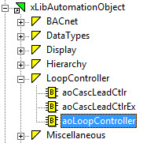
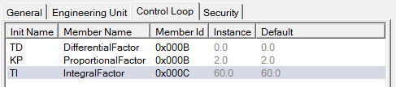

Loop controller
  Universal PID controller (P, PI, PD, PID) with modulating output.
  Feedback signal input for the present control element position. If no real position feedback available, connect the analog output object PrVal to the AFBV input.
  Adjustable high and low limits for the output, Connect high and low inputs to the analog output object outputs.
  Connectable with further controllers to create sequences (SQ inputs and outputs).
SPV – set point value.
PRV – present value.
ERPRV – present value error.
ENBL – enable.
AO_UNA – control element unavailable.
AFBV – control element position feedback.
High – limit for the AO output.
Low – limit for the AO output.
INV – Invert control direction.
SQFM – sequence link (from more).
SQFL – sequence link (from less).
AO – output to analog output object.
– HVAC control functions
100 %
Output
Heating sequence
max. output - min. output
100% - 0%
100
KP =
=
=
=
20
proportional band (XP)
5
5
0 %
Proportional band 5 deg K
SPV
16 deg C
21 deg C

Slide 12
Loop controller → Exercise 2,3,4
  Sequence (SQxx) inputs and outputs to avoid multiple controllers operating simultaneously.
  If there is more than one controller in a sequence (e.g. heating and cooling), use the sequence in/outputs of the loop controller.
  Sequence inputs: Sequence outputs:
    SQFM – from more SQTM – to more
    SQFL – from less SQTL – to less
Termination
SQFM
SQTM
4
SQFL
SQTL
Heating sequence 2
SQFM
SQTM
3
SQTM SQTL
SQFL
SQTL
1
Heating sequence 1
– HVAC control functions
SQTM
SQTL
2
SQFM
SQTM
SQFL
SQTL
KP +
KP -
Termination
Cooling sequence 1
Heating sequence 2
Heating sequence 1
Cooling sequence 1
Heating demand
Cooling demand

Slide 13







Cascade lead controller
  Used to determine the supply air temperature set point based on the room air temperature.
  Used in conjunction with a PID controller for the supply air controller control sequence.
– HVAC control functions
SPV – set point value (room air temp set point).
SPBAND – set point deadband.
SPSEL – set point selection.
PRV – Present value (room air temp).
ERPRV – Present value error.
ENBL – enable.
SPVC - set point value cooling
SPVH - set point value heating

Slide 14

Time Schedule → Exercise 5
New recording
Just referring to the exercise not explaining the schematic in detail
Delete that box when recording
  A Time Schedule can be used to:
    Switch on and off the Unit
    Switch Stages
    Change set points (analog Value)
    Do periodically pump running cycles
    …
  The time scheduler provides following features
    Define up to 6 switch events for each week day and one exception day
    Define up to 10 Calendar conditions for the exception day
– Time schedule
Define Day Plan (Mon-Sun) + Exception
If the Date is active the exception days will be used

